Slide 1
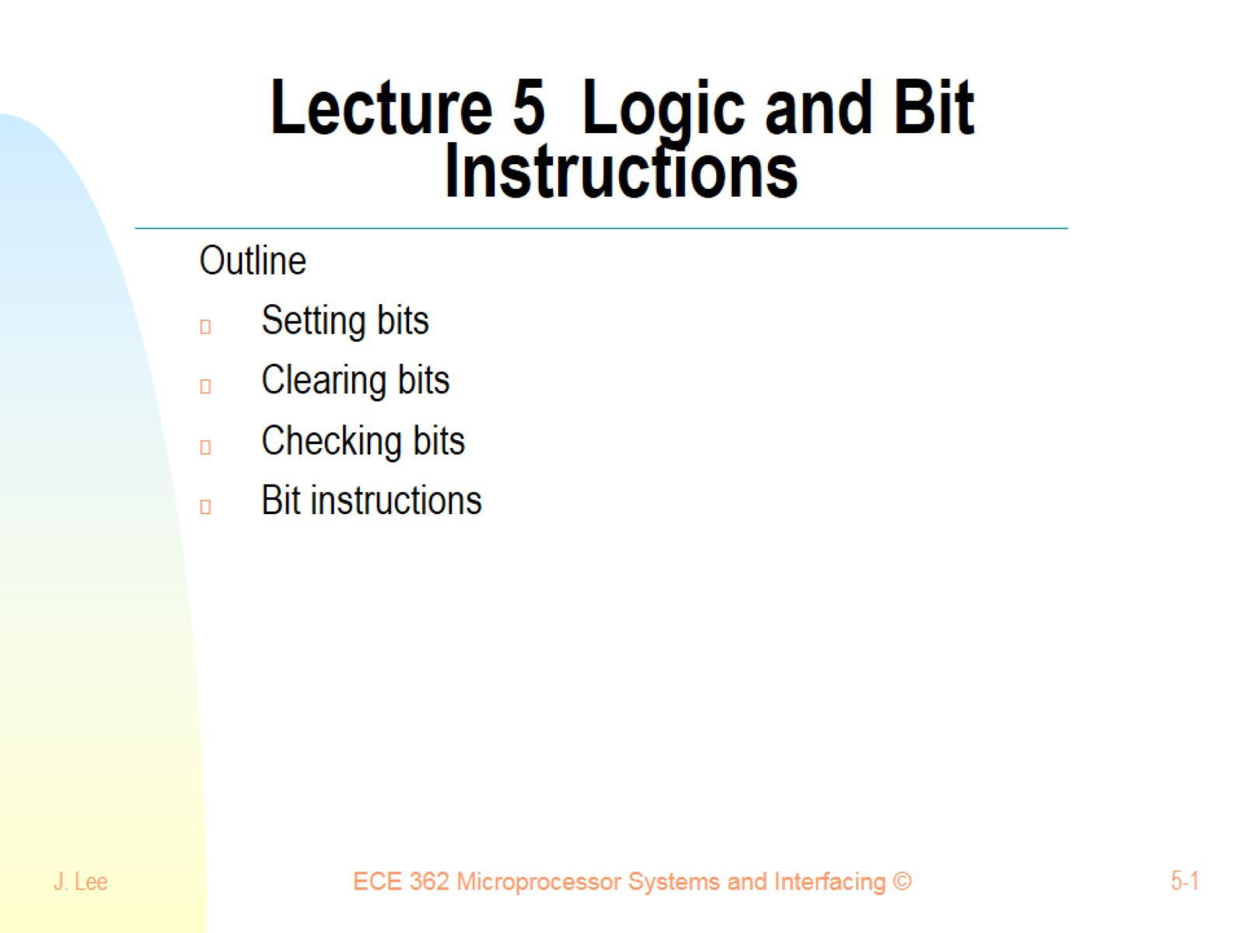
Lecture 5 Logic and Bit Instructions

Slide 2
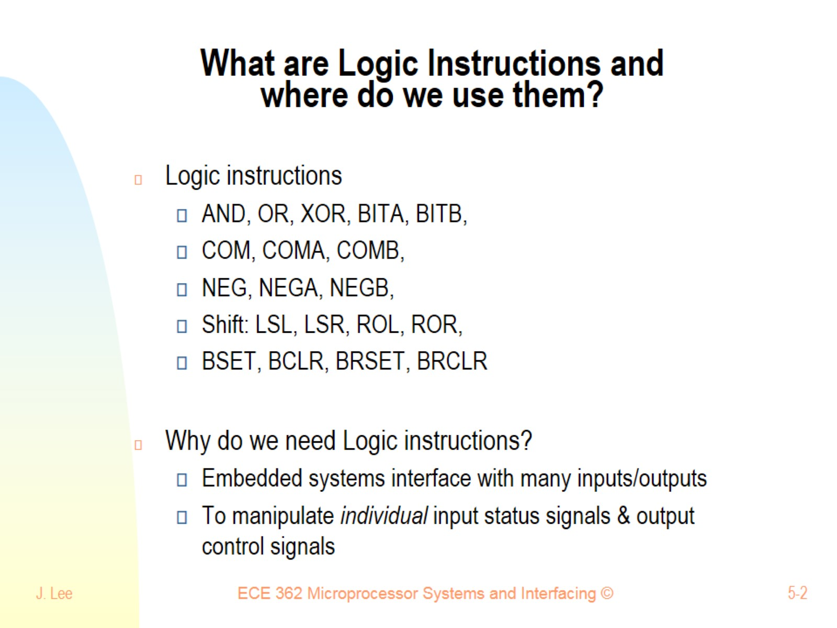
What are Logic Instructions and where do we use them?

Slide 3
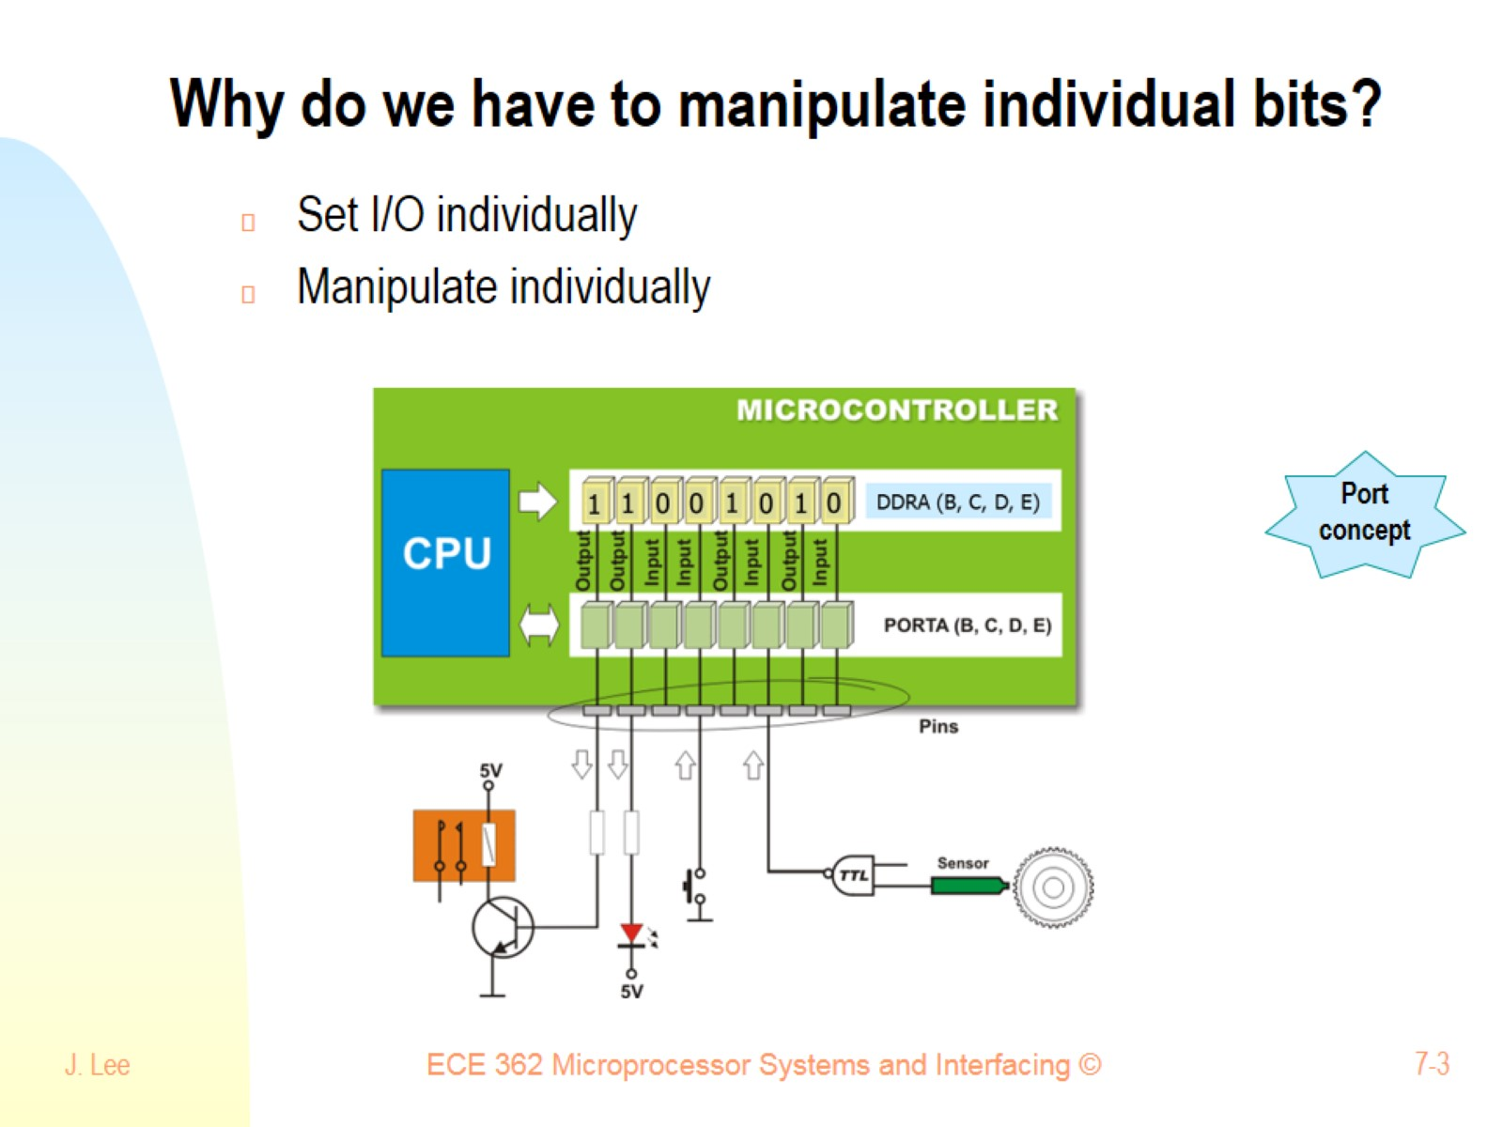
Why do we have to manipulate individual bits?

Slide 4
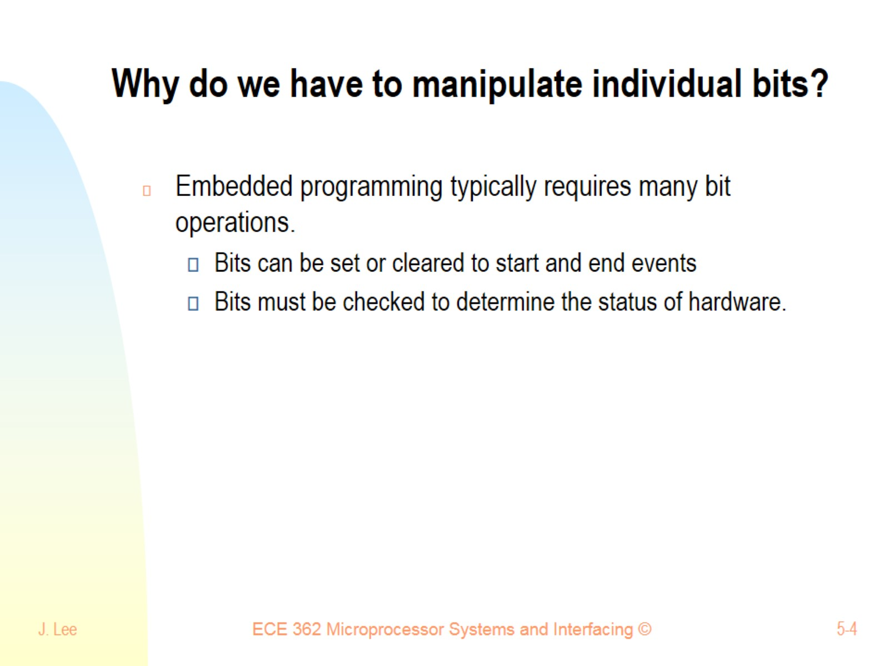
Why do we have to manipulate individual bits?

Slide 5
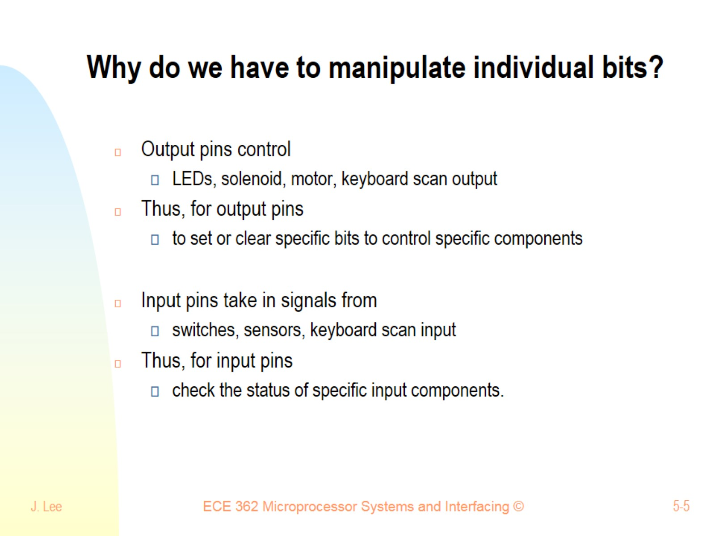
Why do we have to manipulate individual bits?

Slide 6
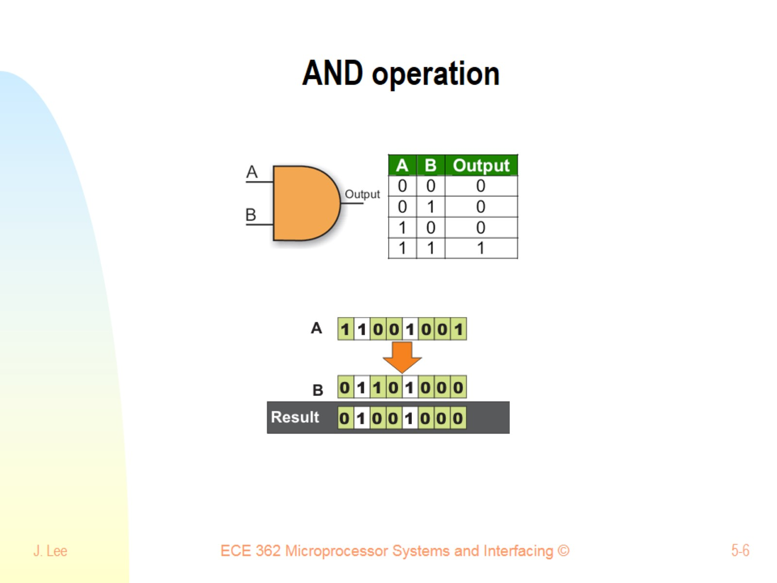
AND operation

Slide 7
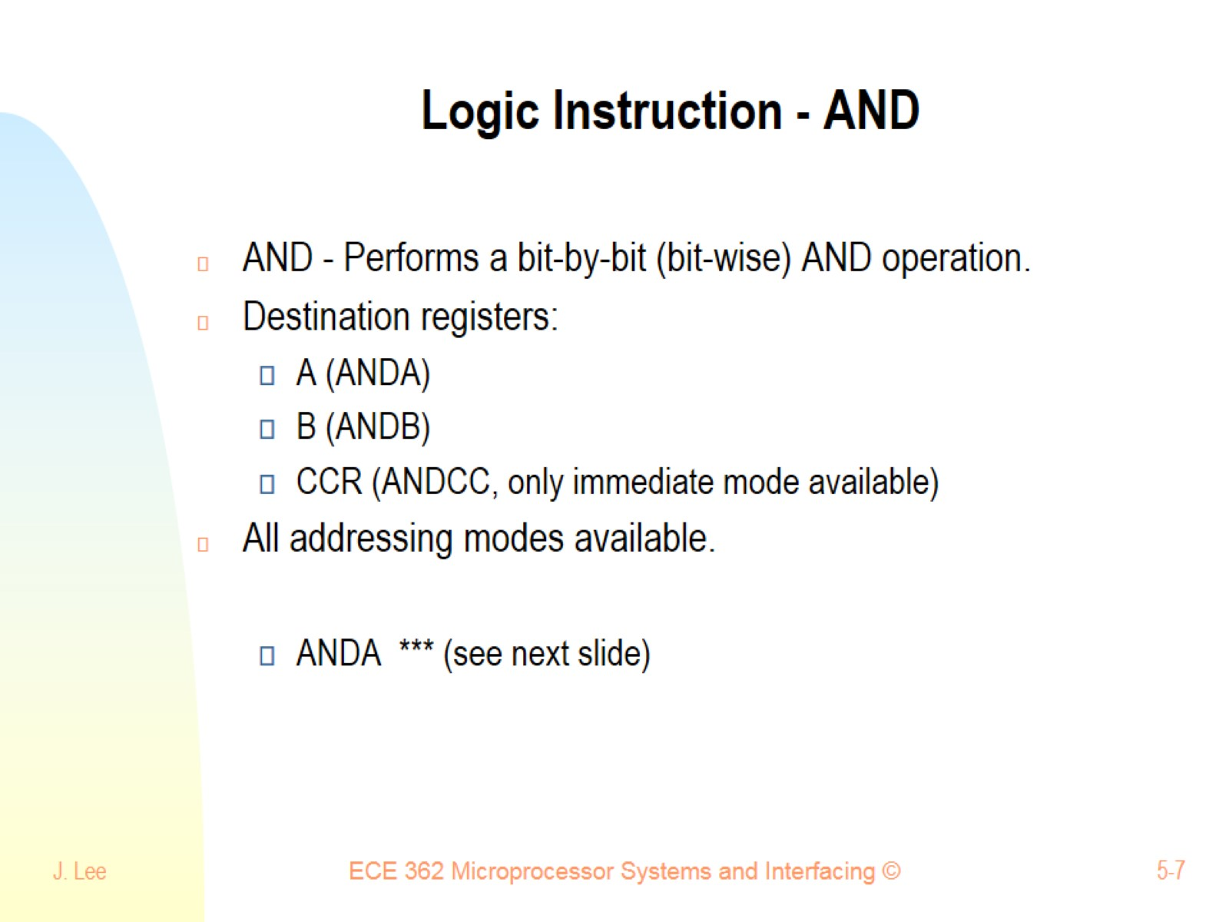
Logic Instruction - AND

Slide 8
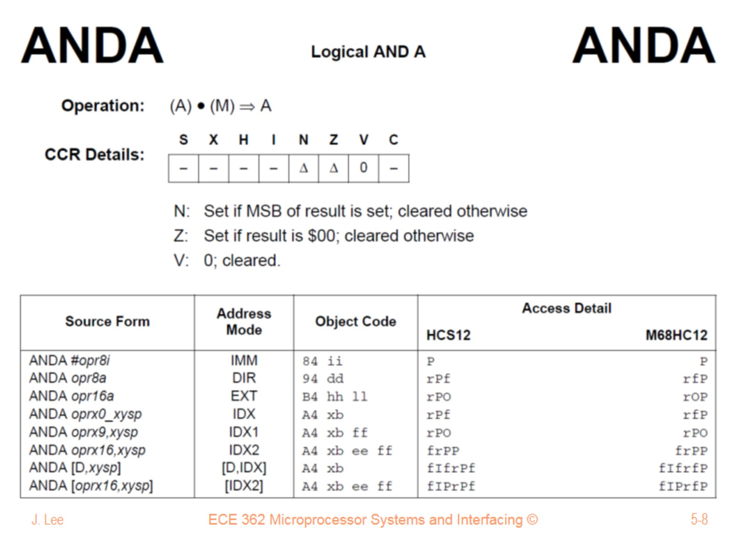

Slide 9
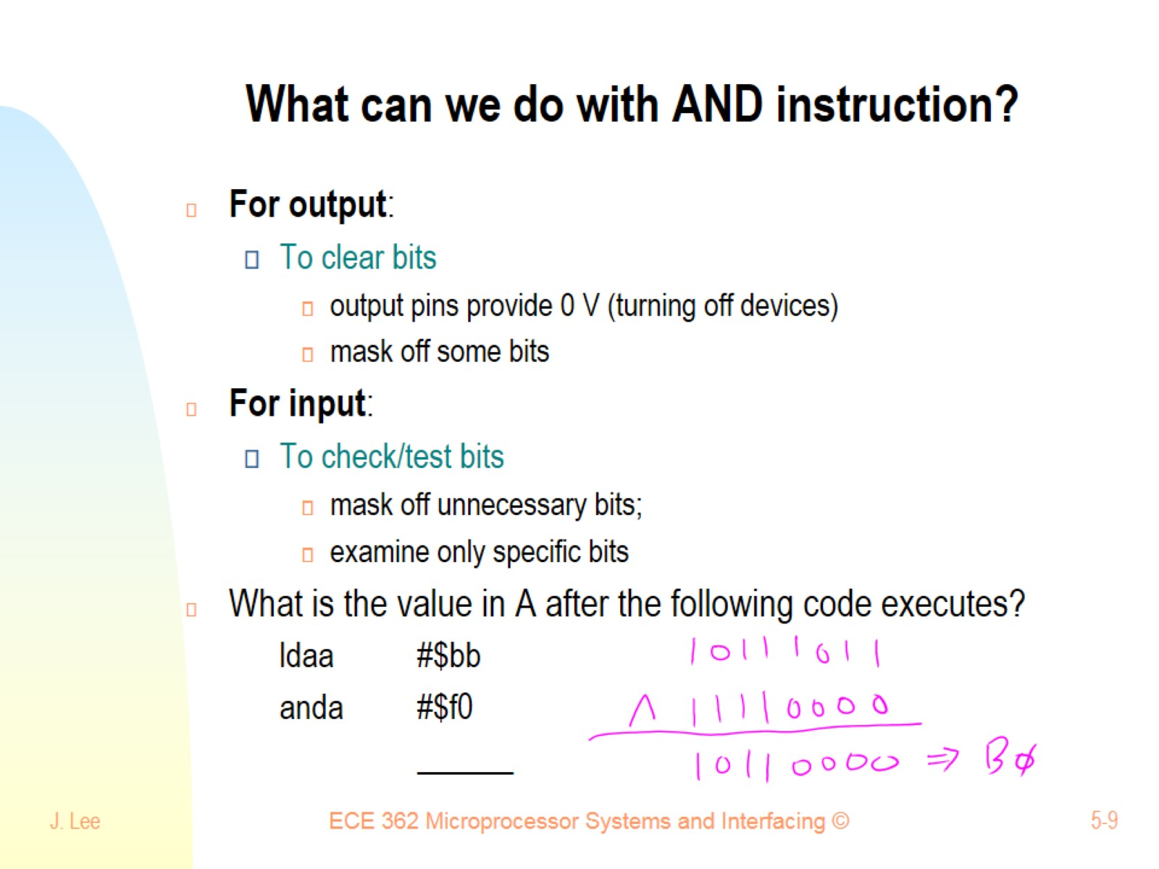
What can we do with AND instruction?

Slide 10
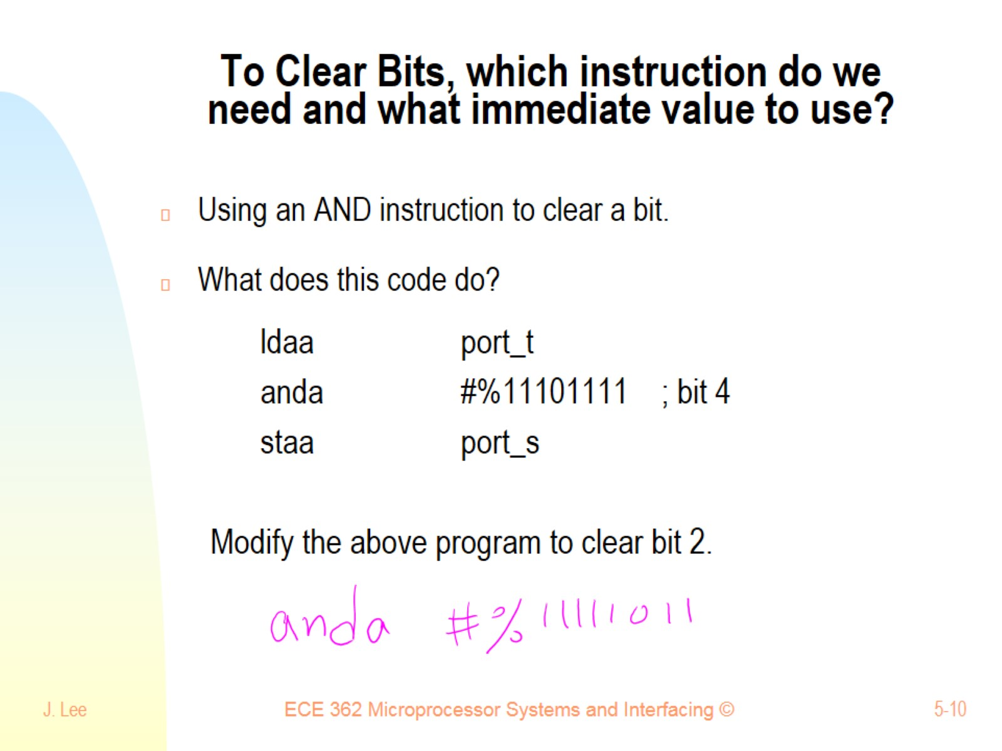
To Clear Bits, which instruction do we need and what immediate value to use?

Slide 11
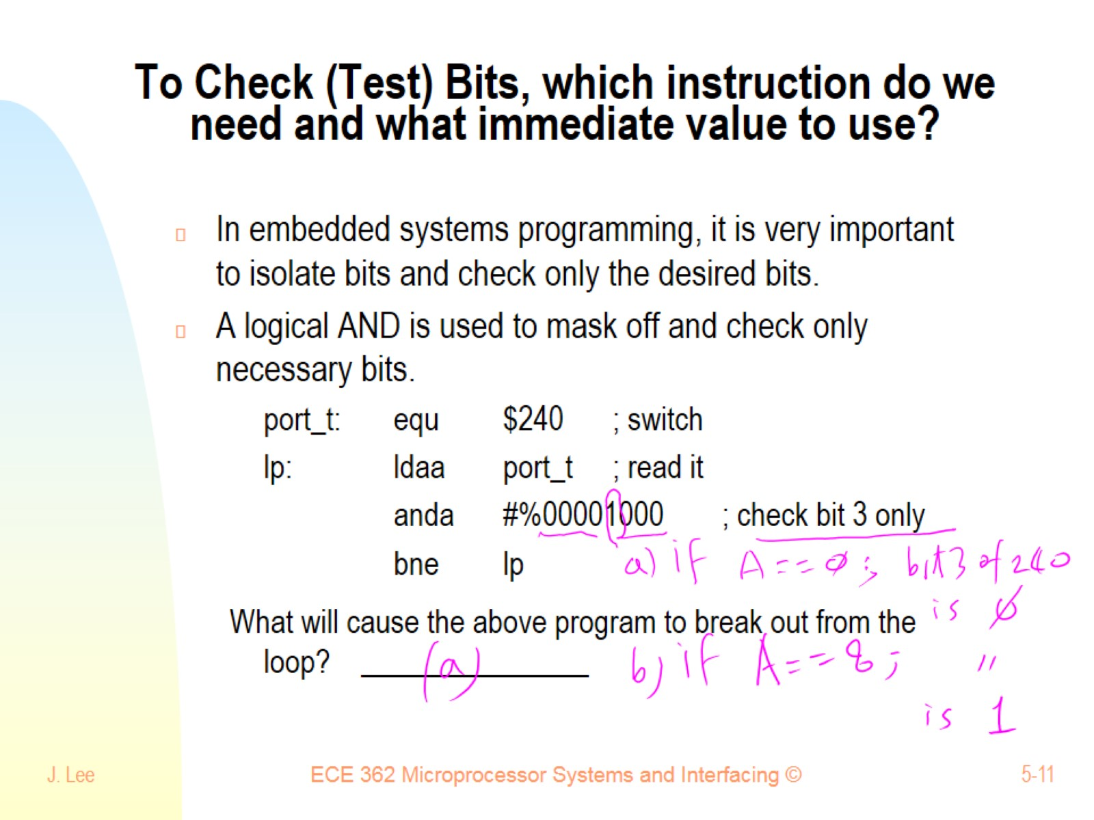
To Check (Test) Bits, which instruction do we need and what immediate value to use?

Slide 12
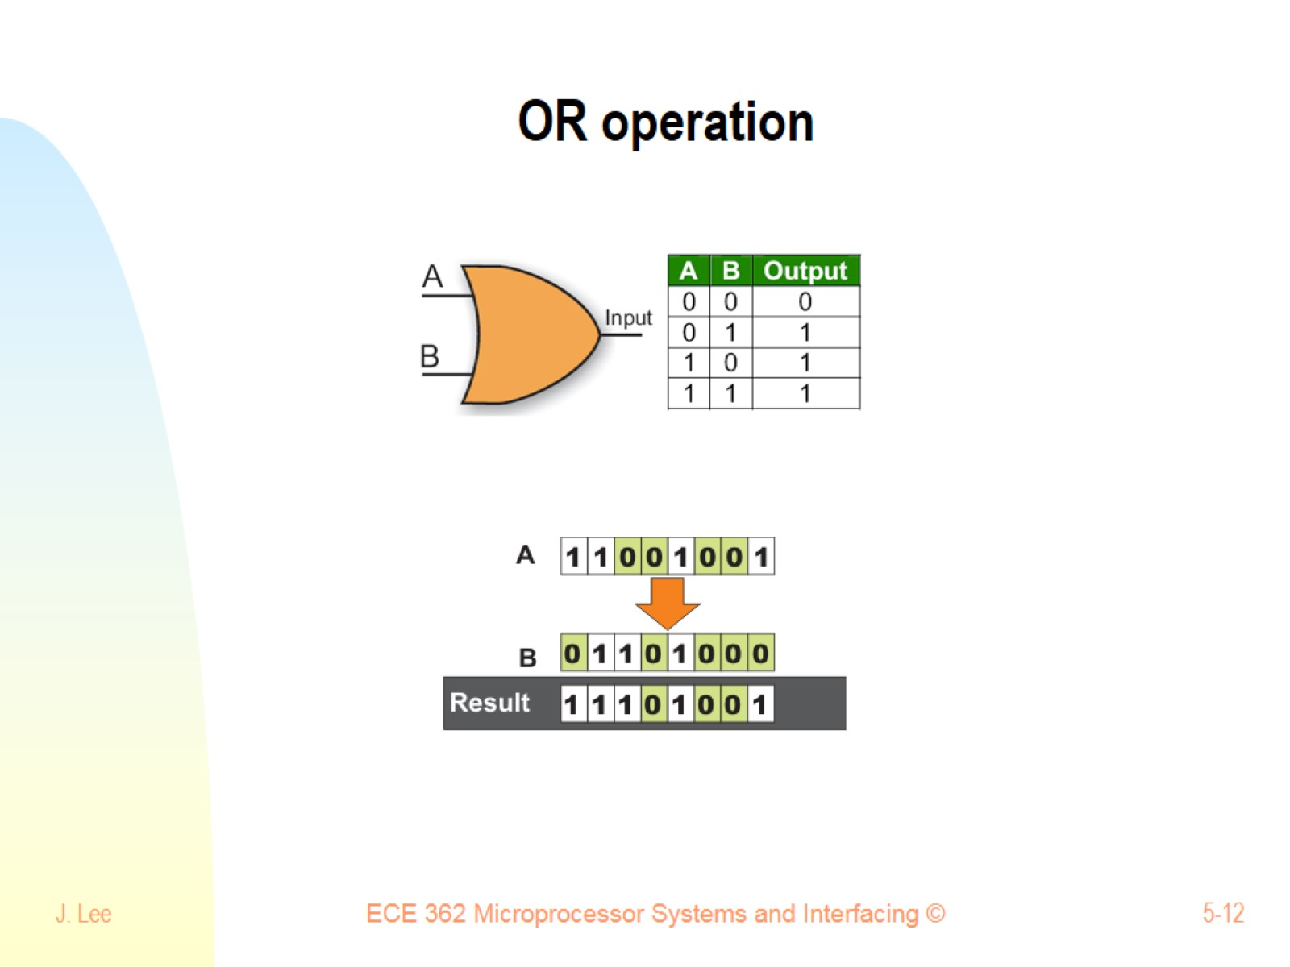
OR operation

Slide 13
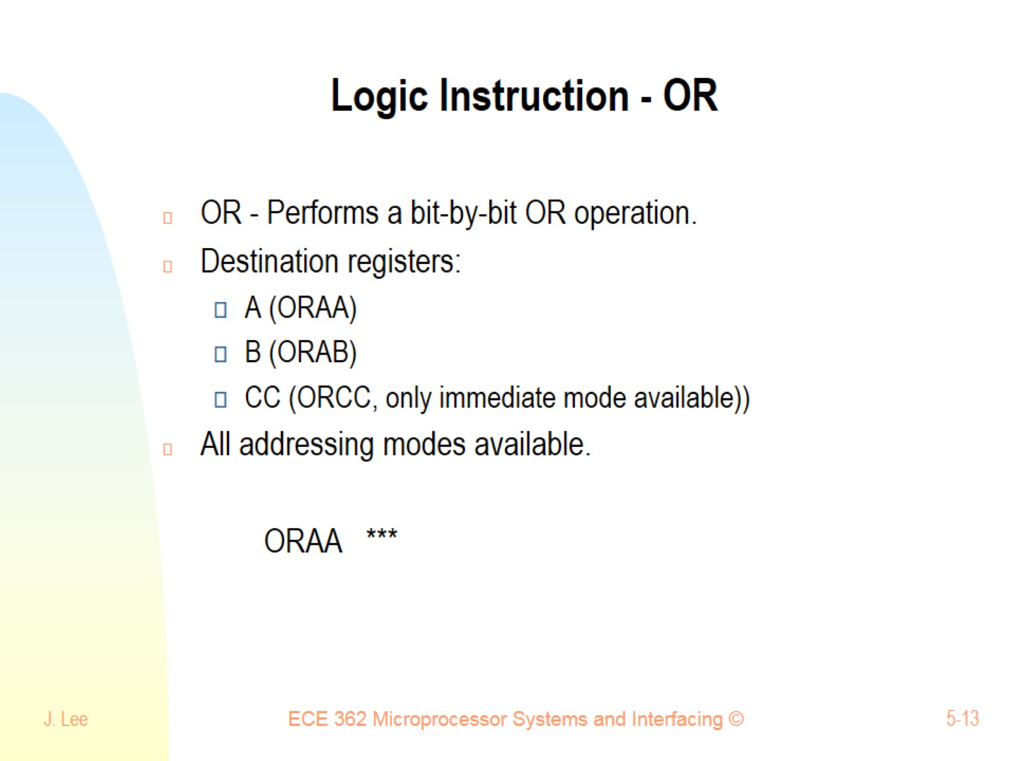
Logic Instruction - OR

Slide 14
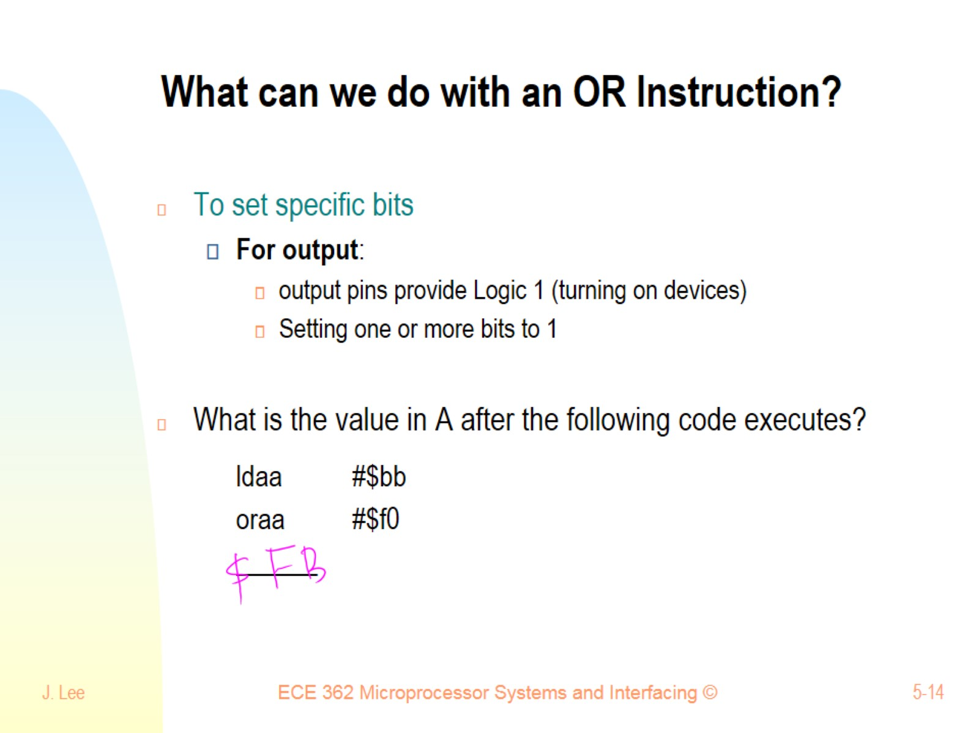
What can we do with an OR Instruction?

Slide 15
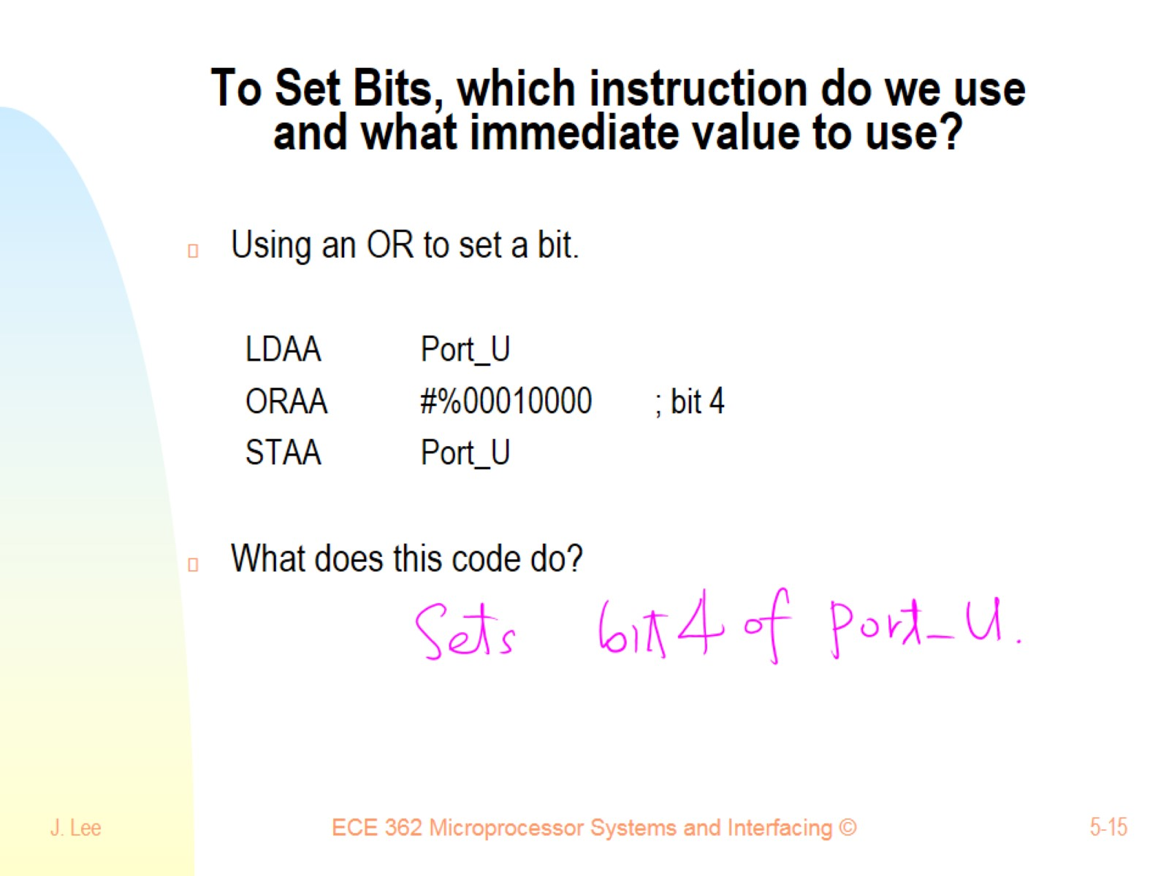
To Set Bits, which instruction do we use and what immediate value to use?

Slide 16
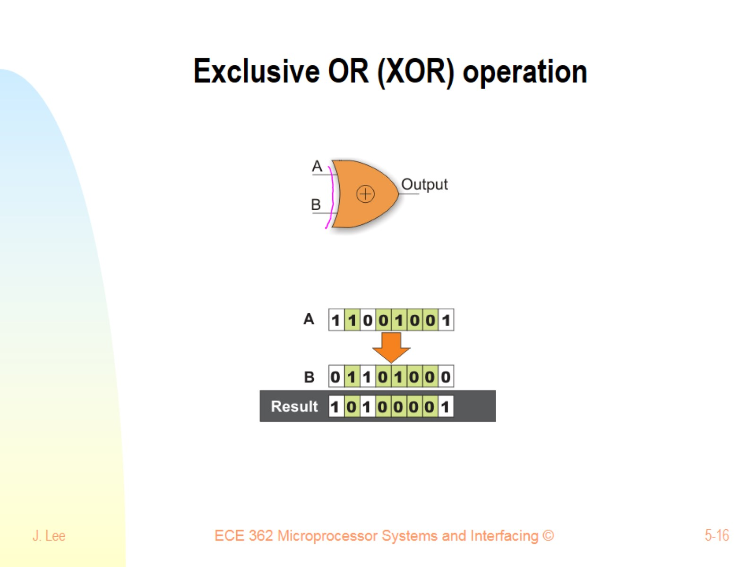
Exclusive OR (XOR) operation

Slide 17
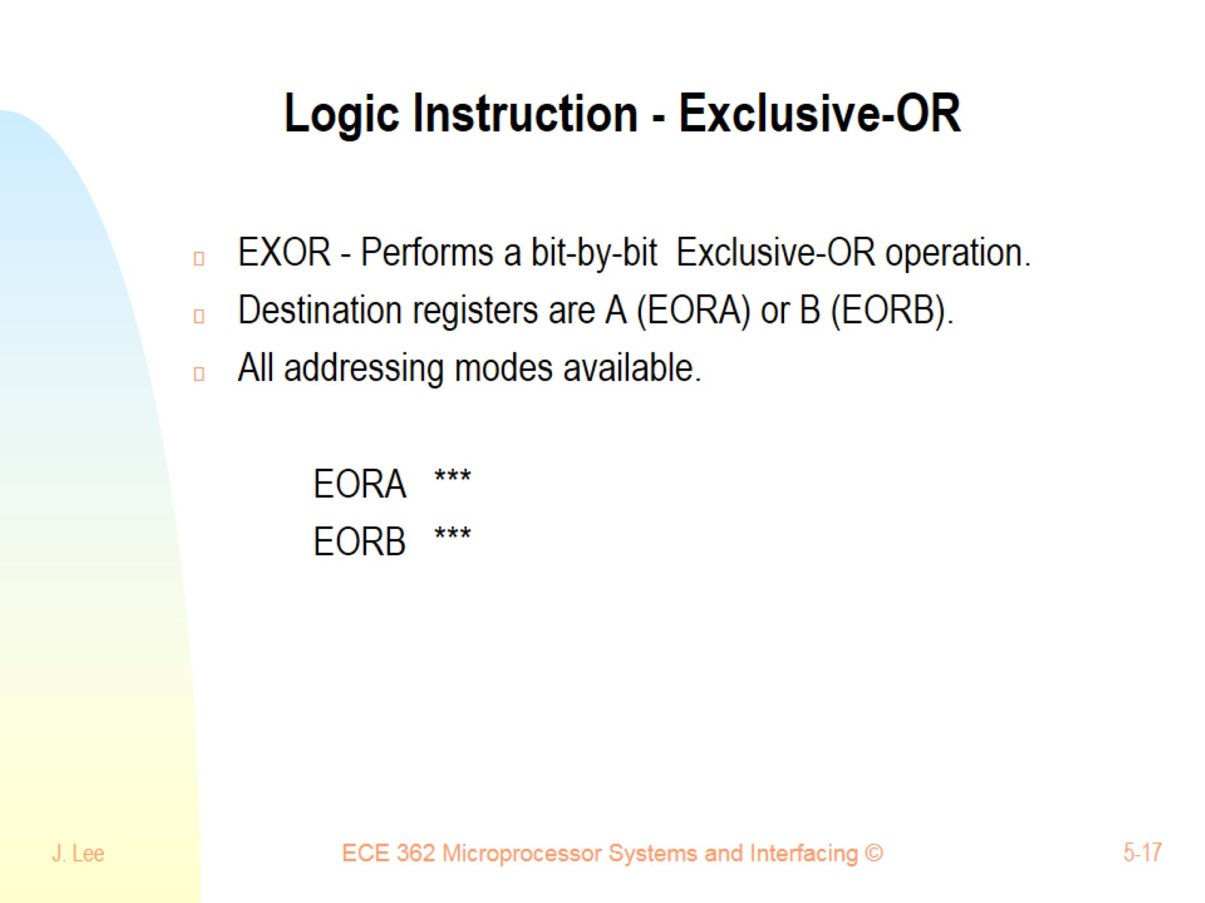
Logic Instruction - Exclusive-OR

Slide 18
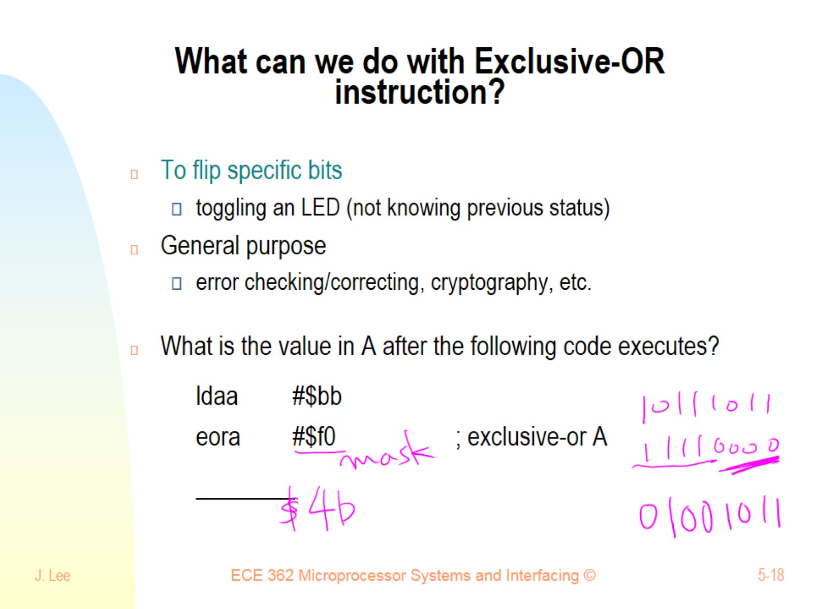
What can we do with Exclusive-OR instruction?

Slide 19
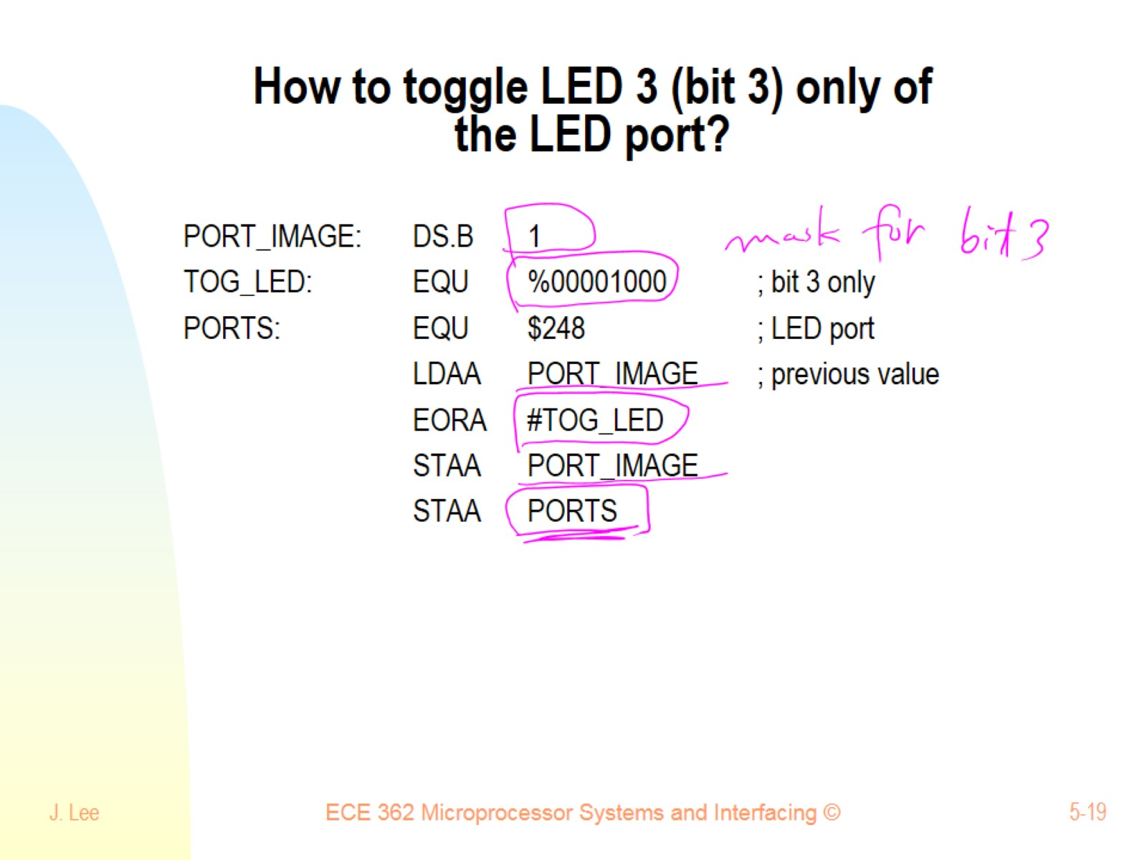
How to toggle LED 3 (bit 3) only of the LED port?

Slide 20
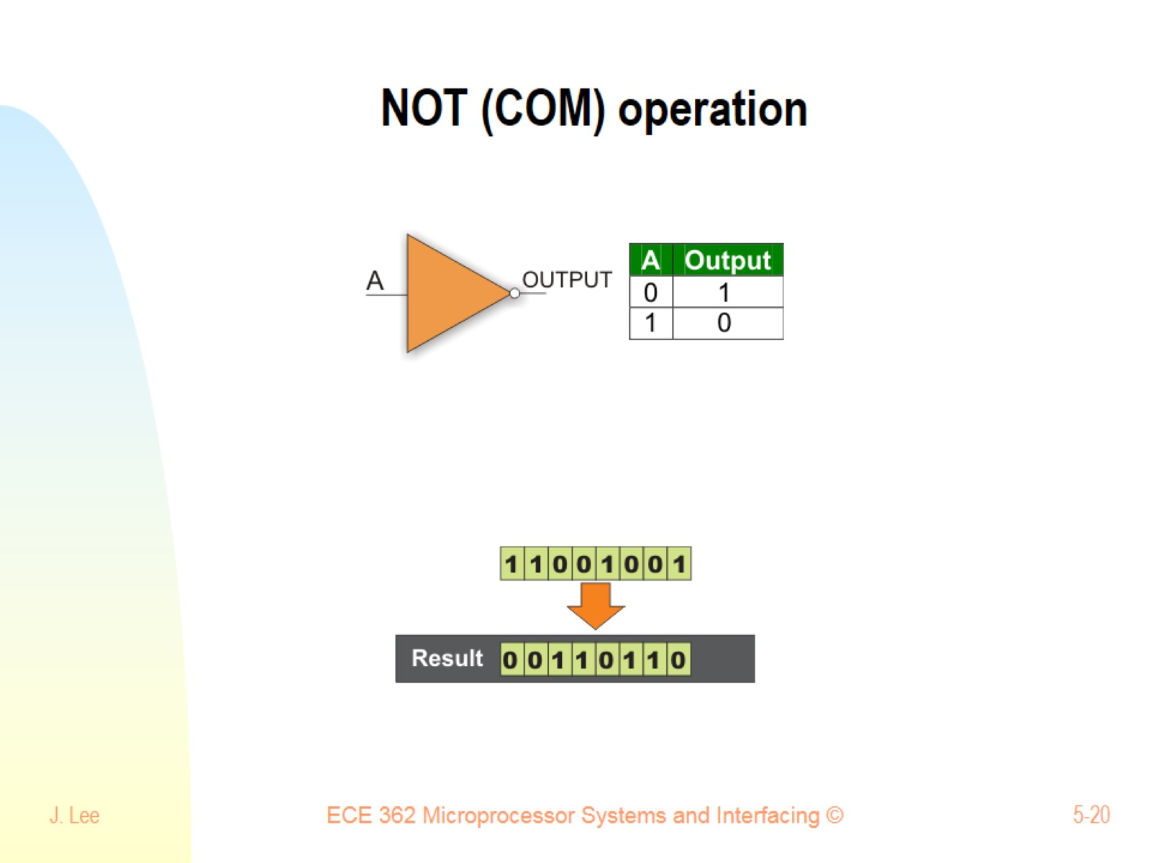
NOT (COM) operation

Slide 21
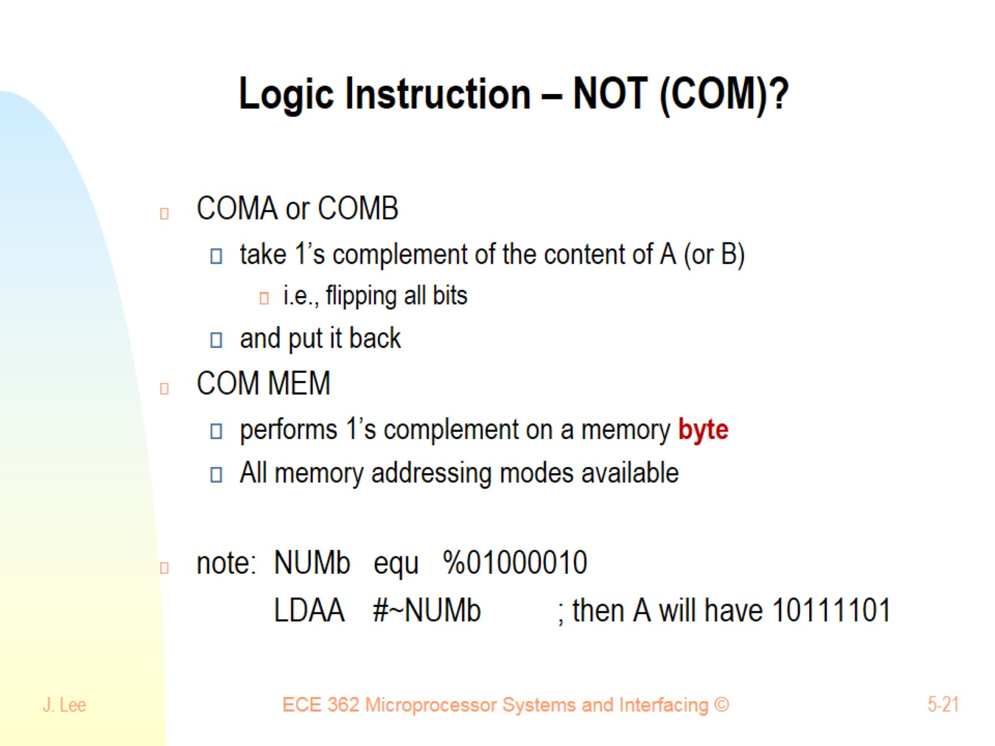
Logic Instruction – NOT (COM)?

Slide 22
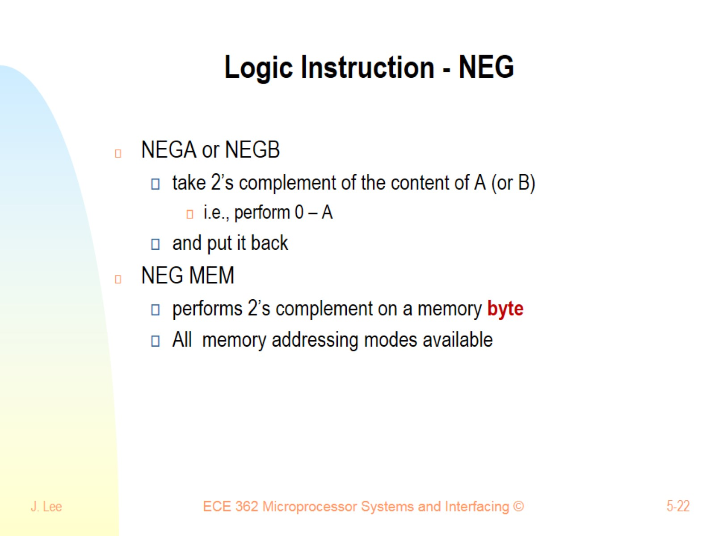
Logic Instruction - NEG

Slide 23
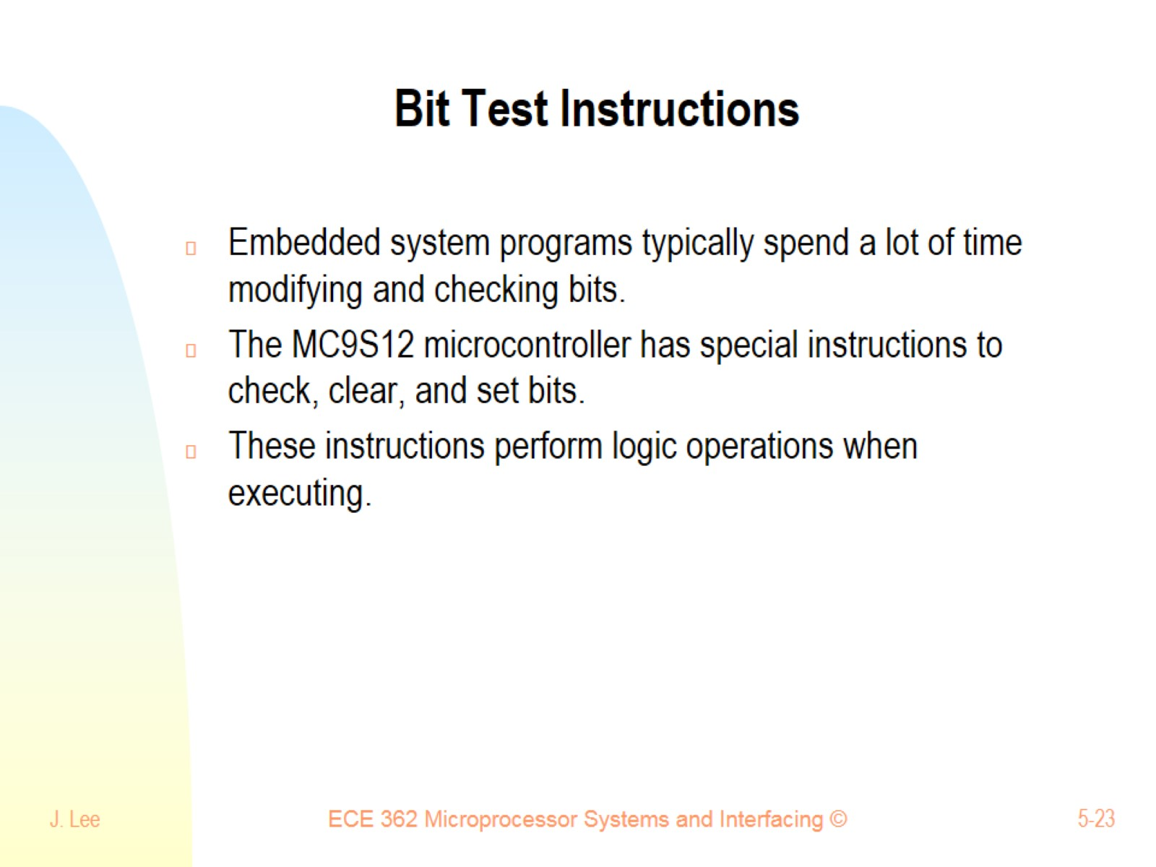
Bit Test Instructions

Slide 24
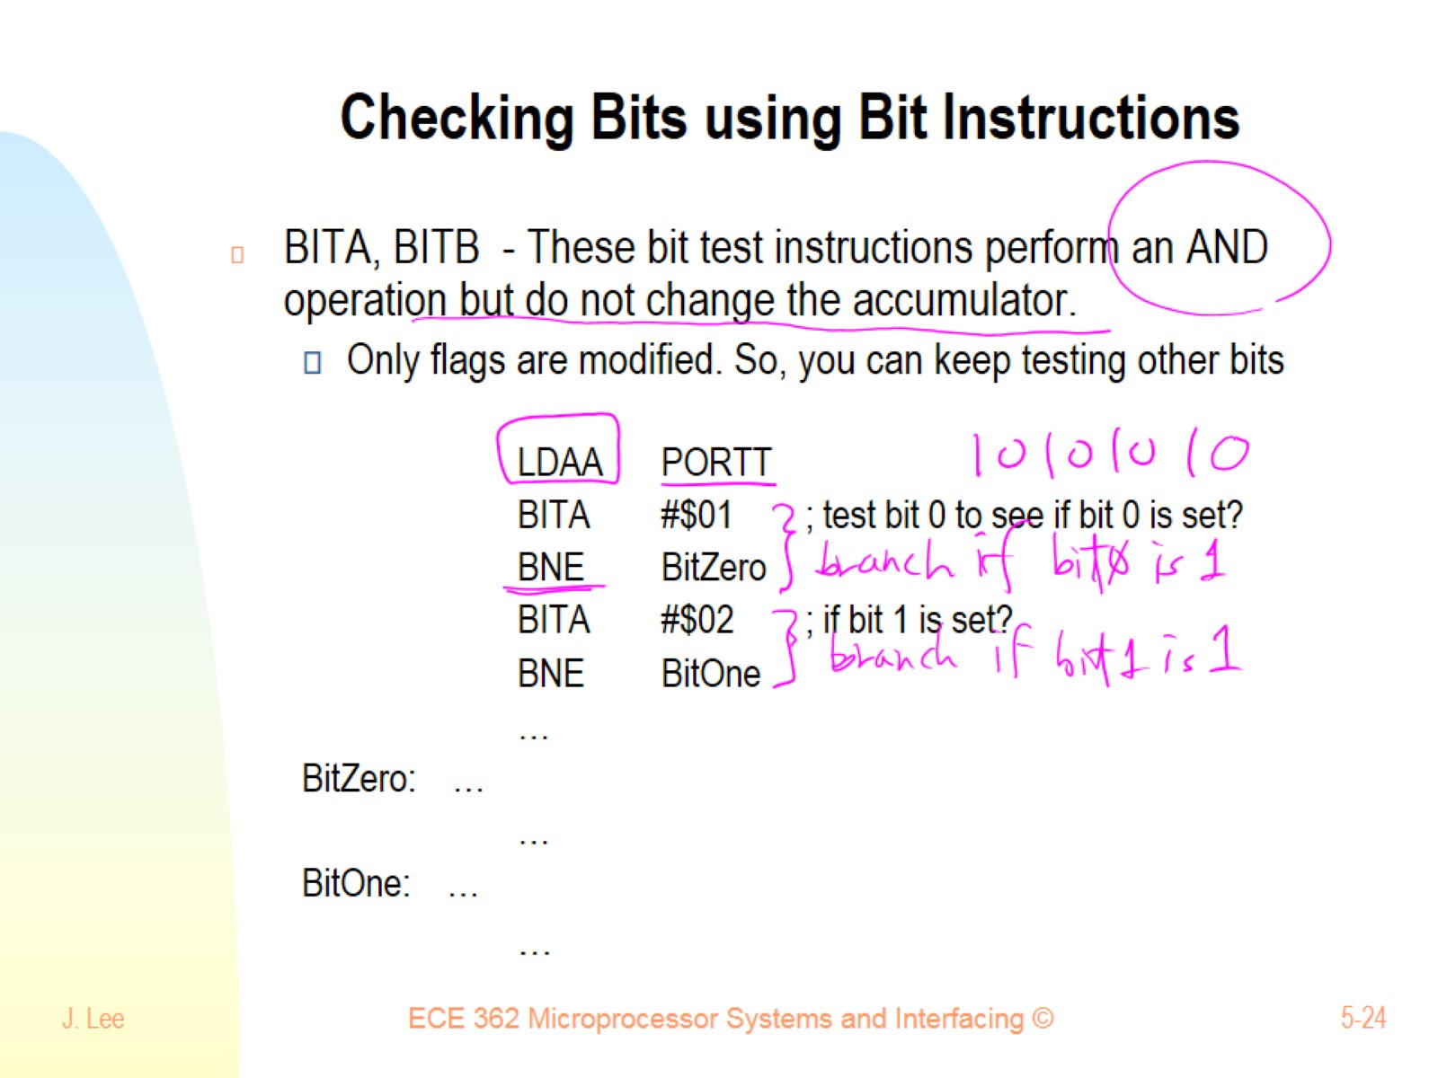
Checking Bits using Bit Instructions

Slide 25
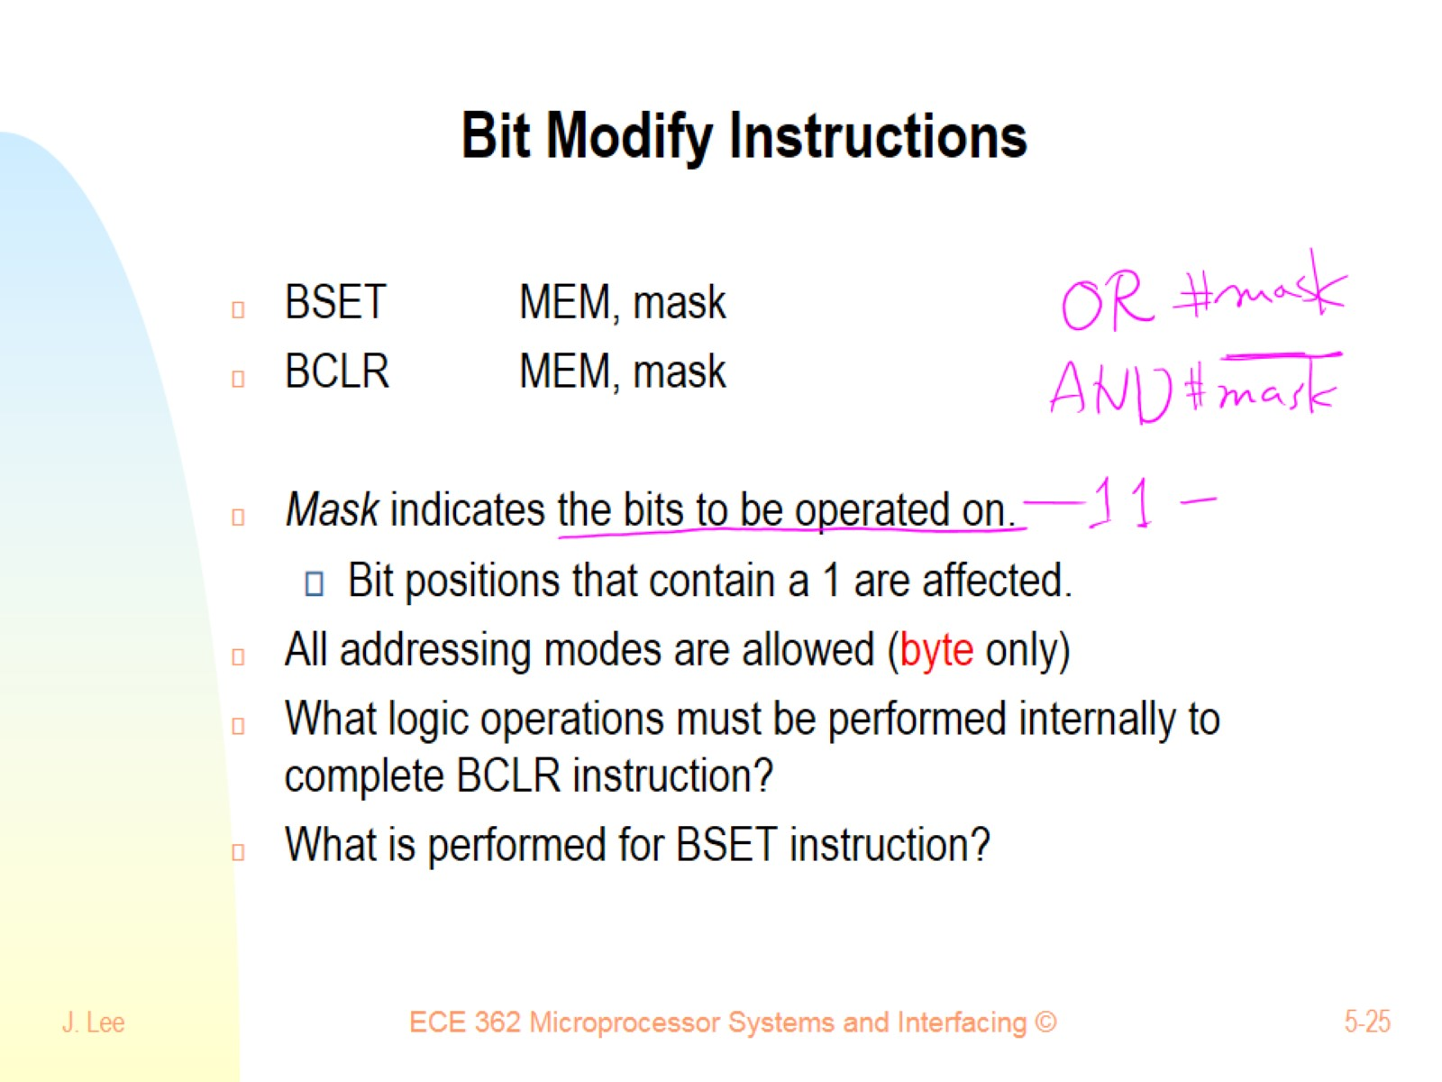
Bit Modify Instructions

Slide 26
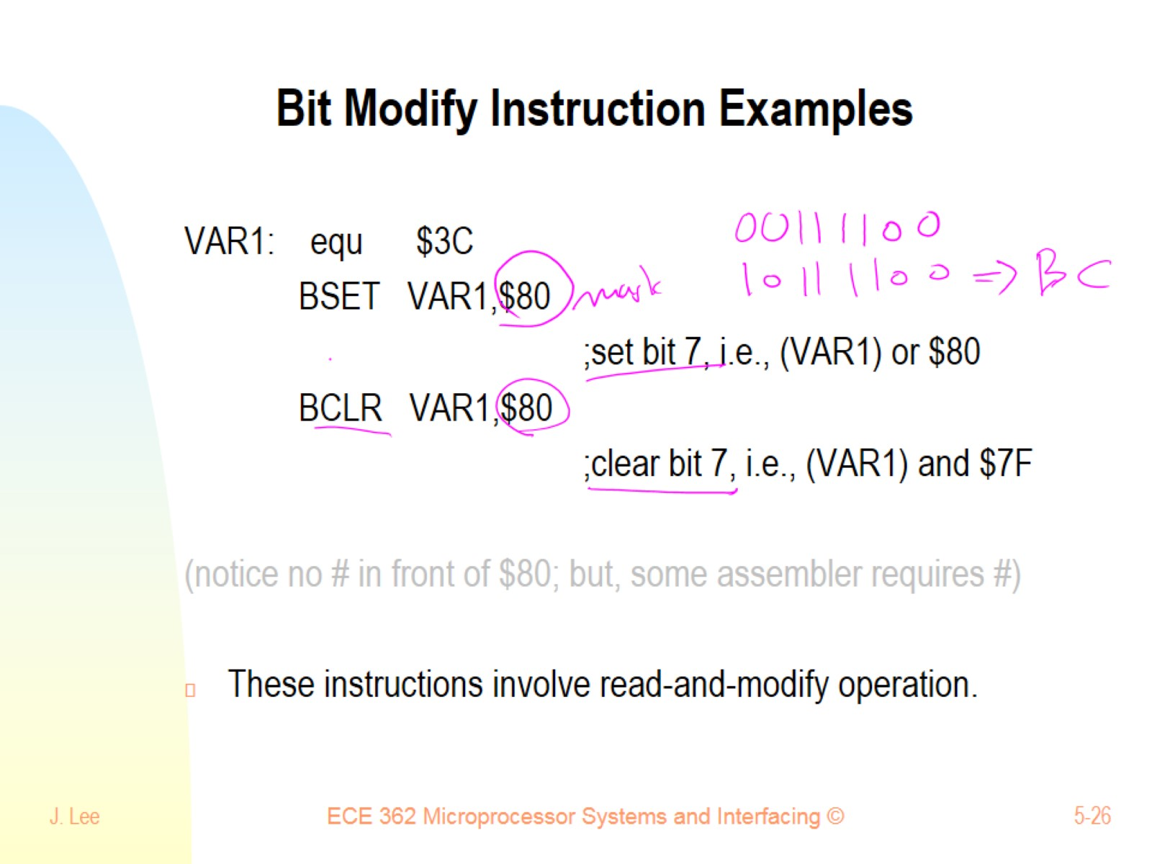
Bit Modify Instruction Examples

Slide 27
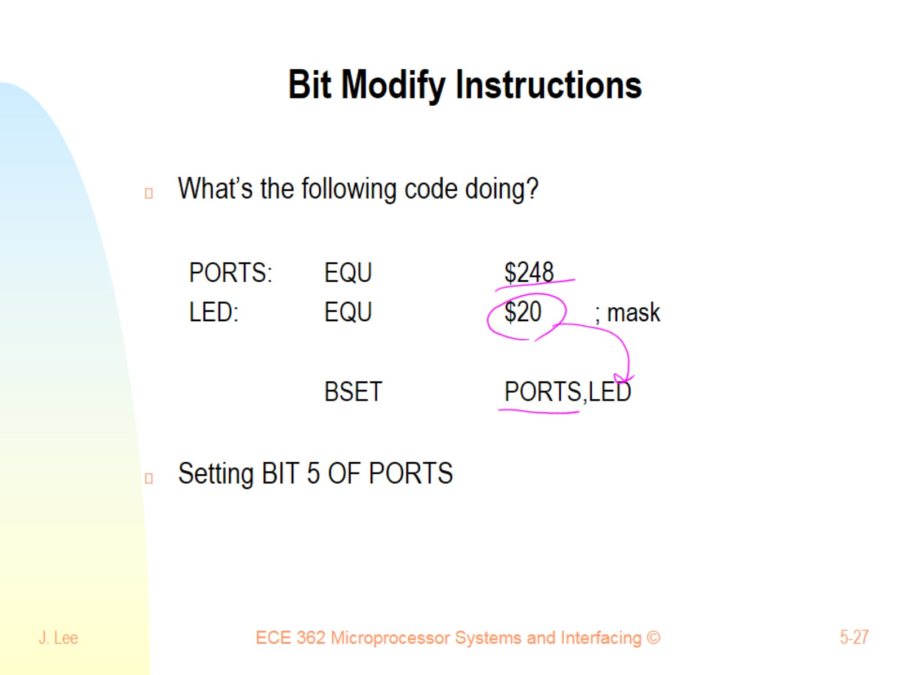
Bit Modify Instructions

Slide 28
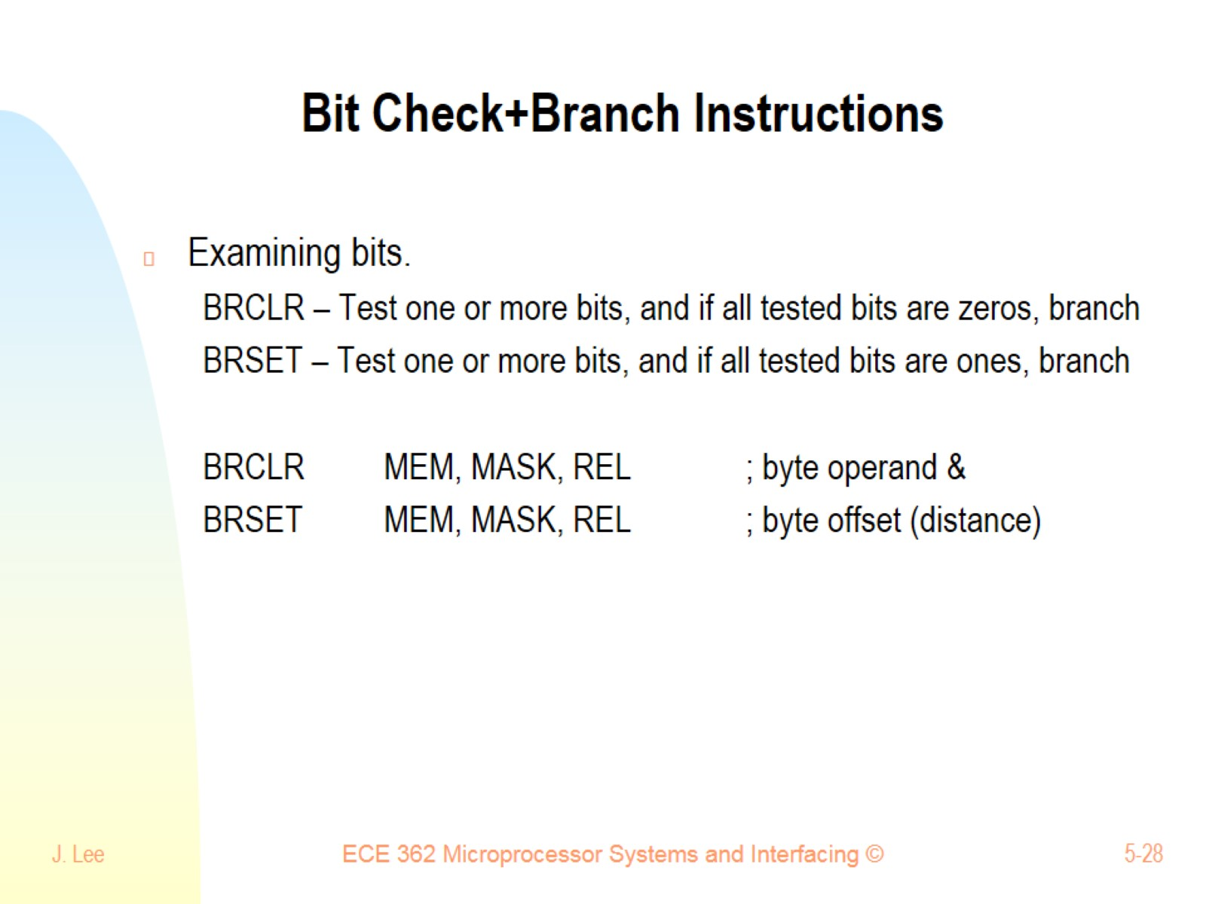
Bit Check+Branch Instructions

Slide 29
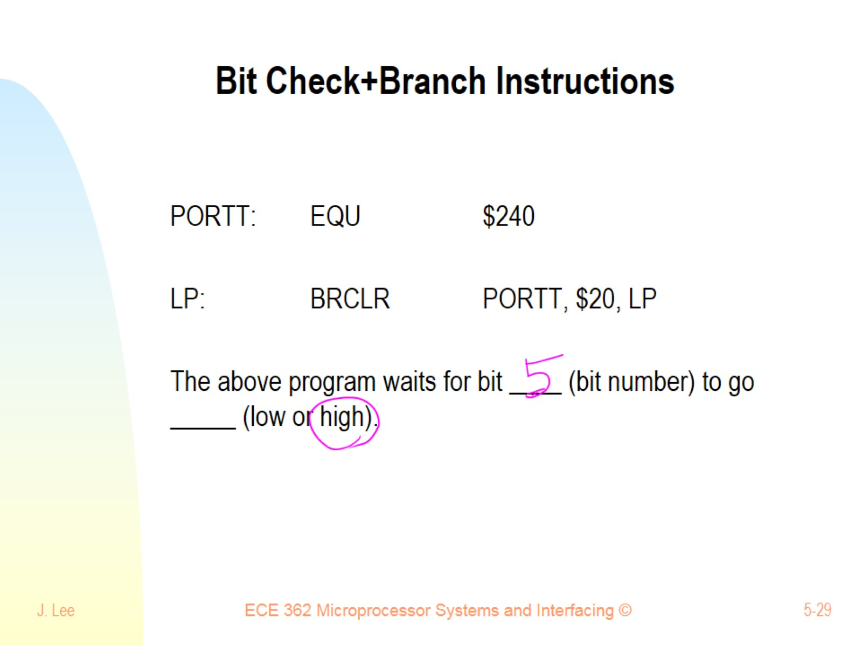
Bit Check+Branch Instructions

Slide 30
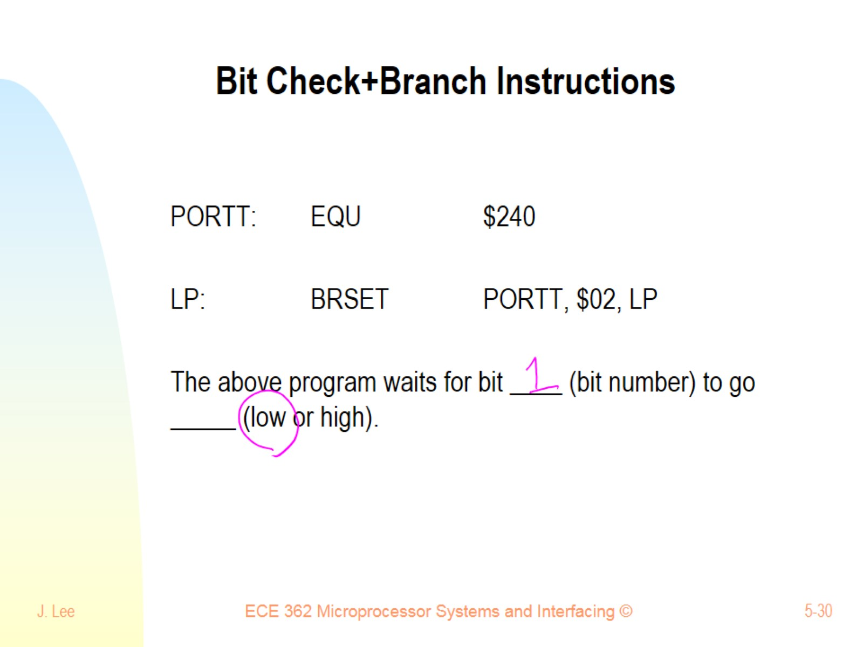
Bit Check+Branch Instructions

Slide 31
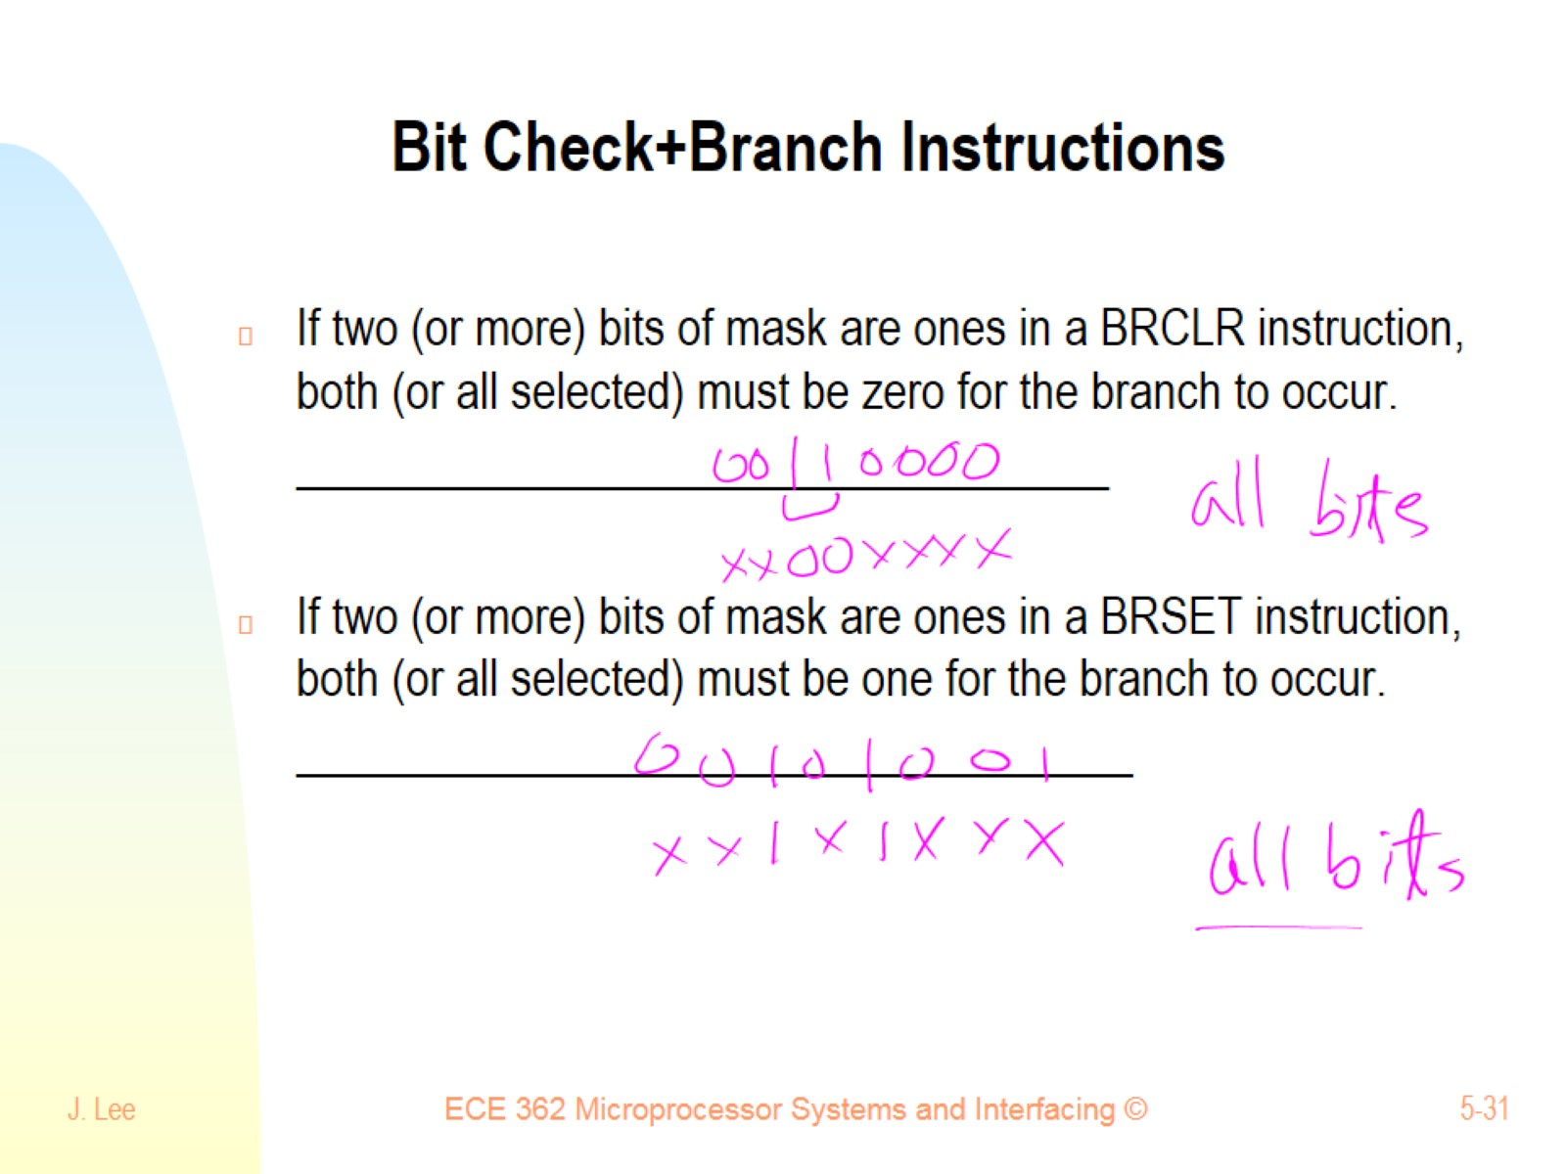
Bit Check+Branch Instructions

Slide 32
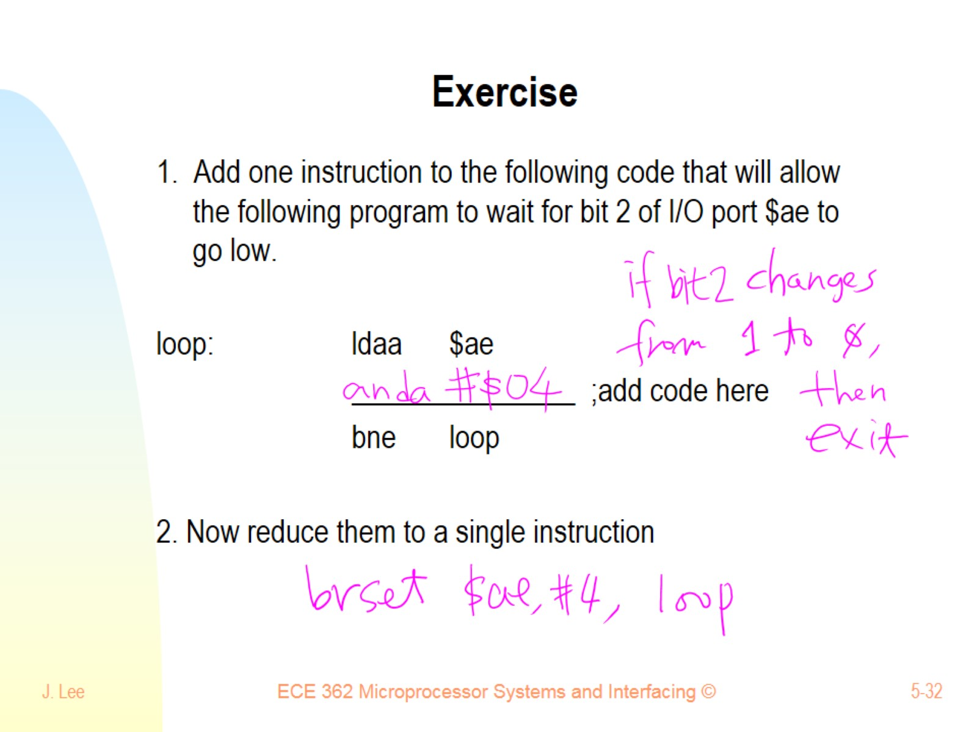
Exercise

Slide 33
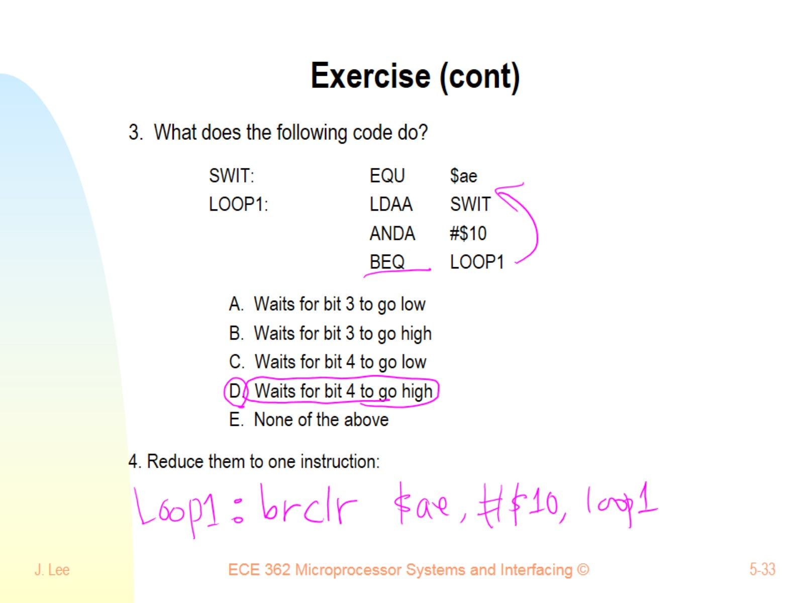
Exercise (cont)

Slide 34
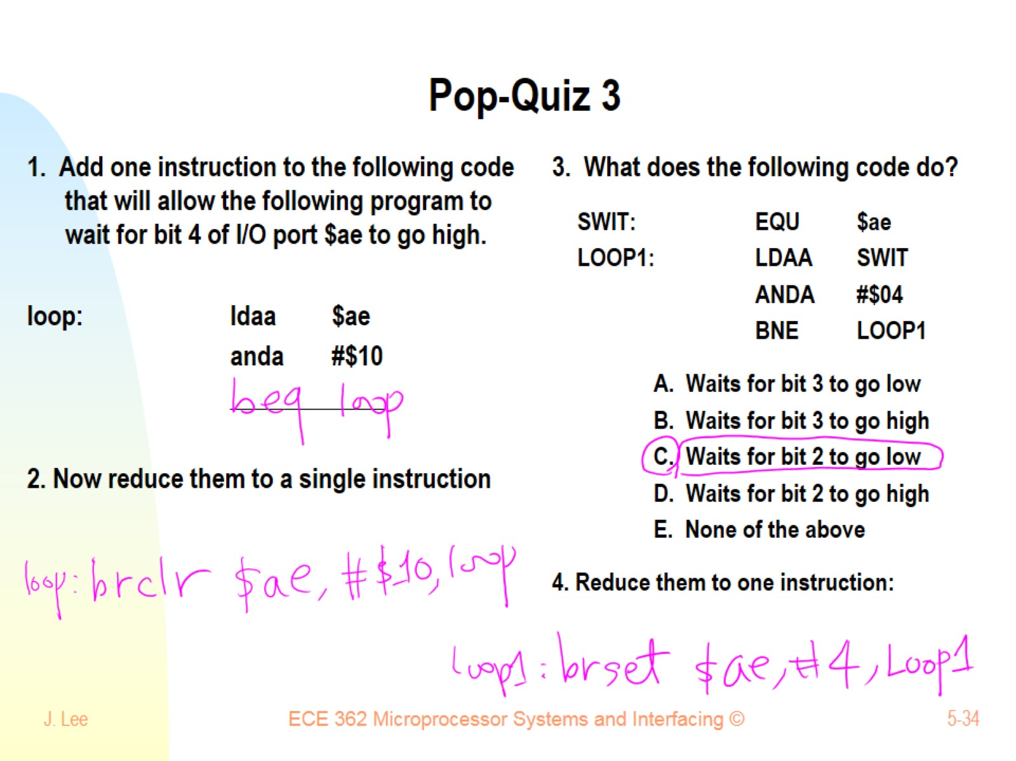
Pop-Quiz 3

Slide 35
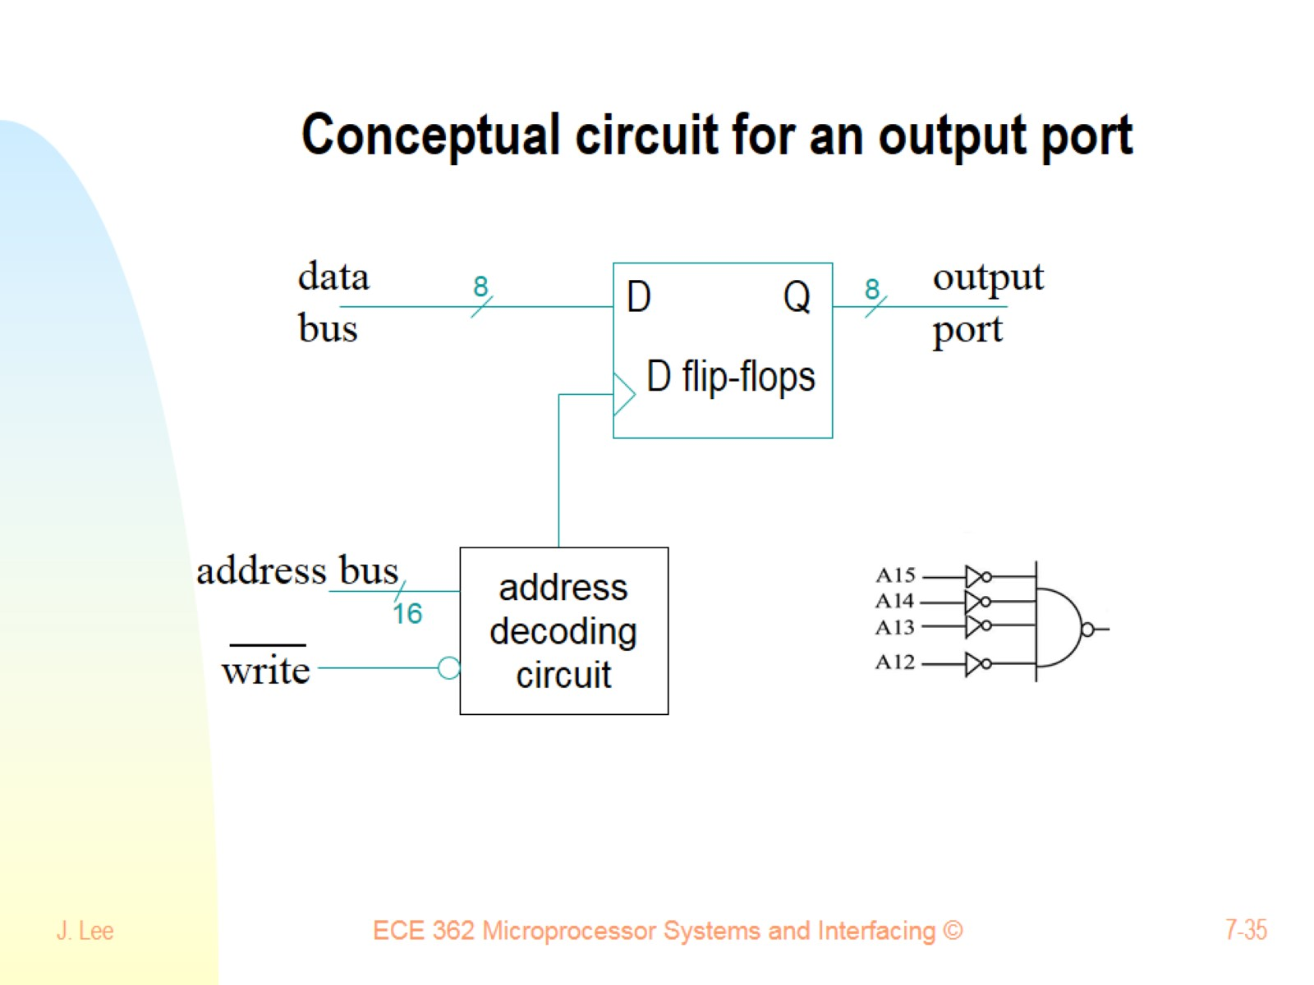
Conceptual circuit for an output port

Slide 36
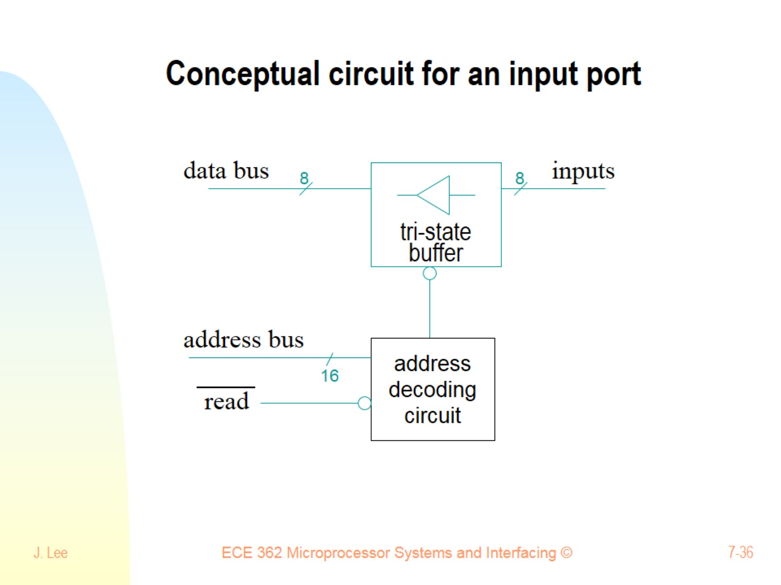
Conceptual circuit for an input port

Slide 37
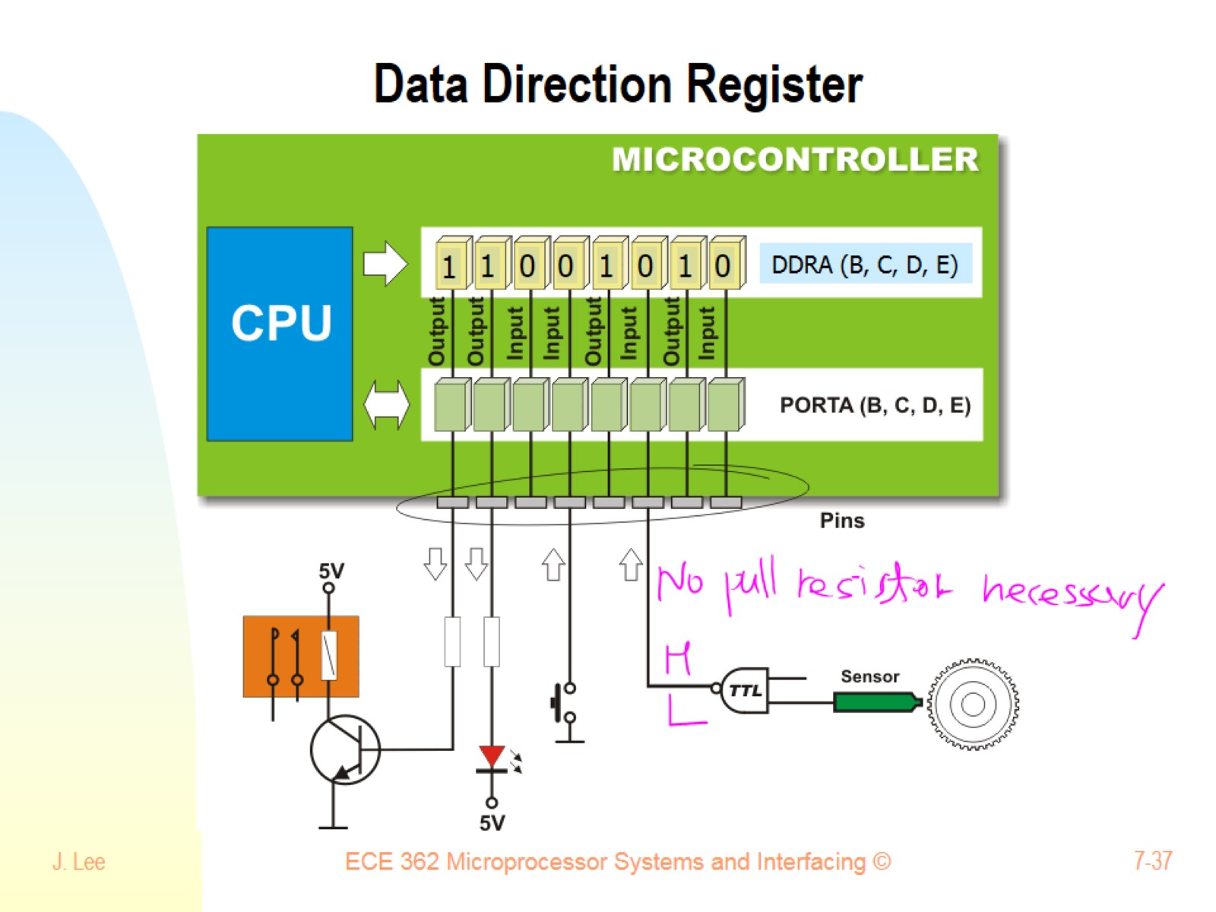
Data Direction Register

Slide 38
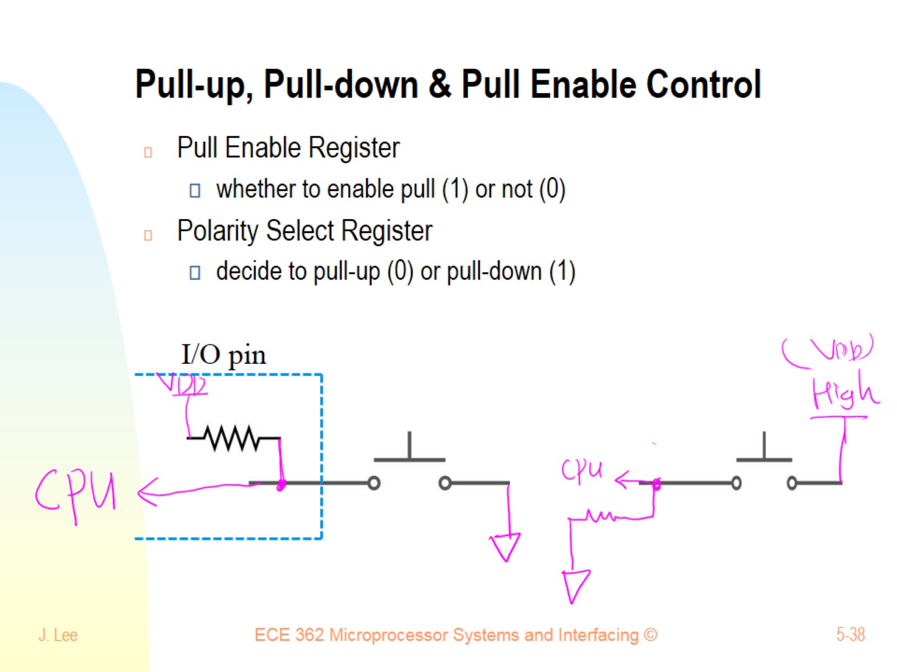
Pull-up, Pull-down & Pull Enable Control

Slide 39
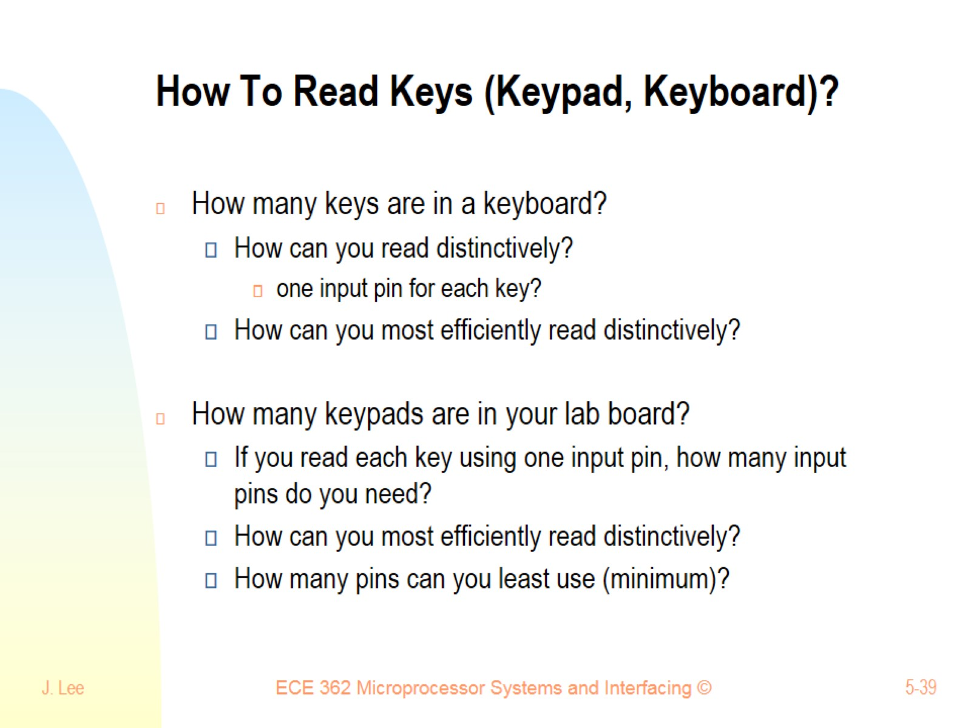
How To Read Keys (Keypad, Keyboard)?

Slide 40
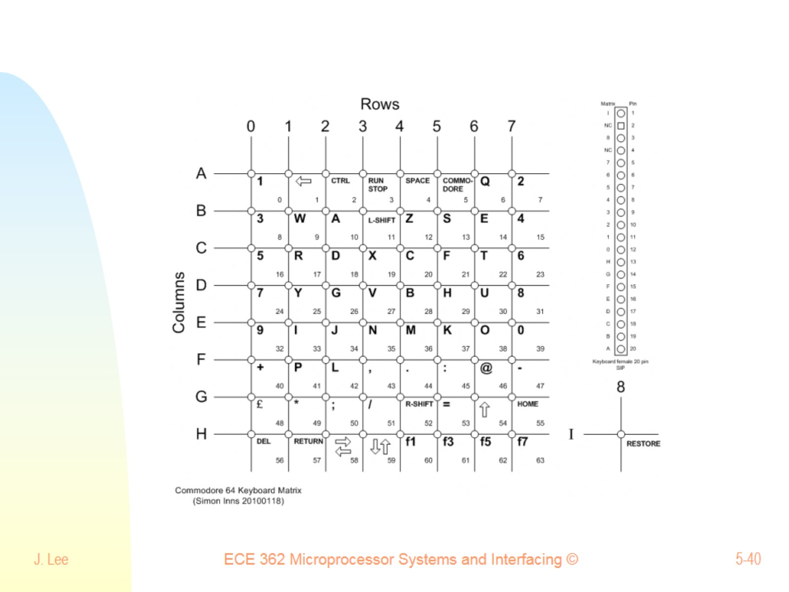

Slide 41
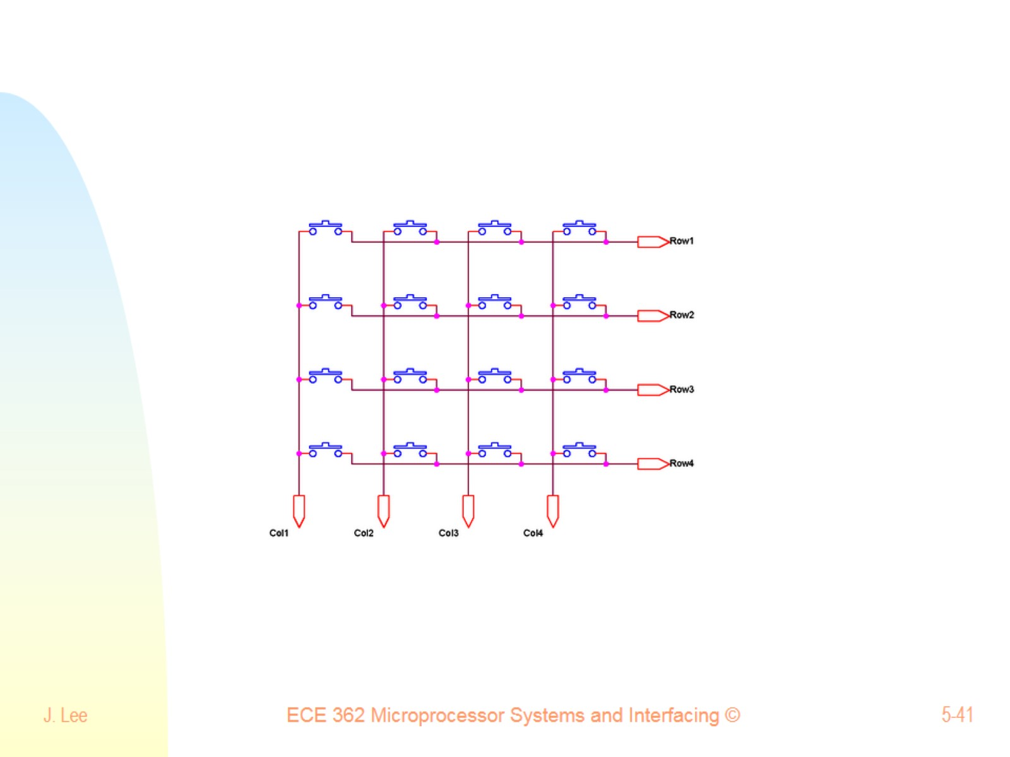

Slide 42
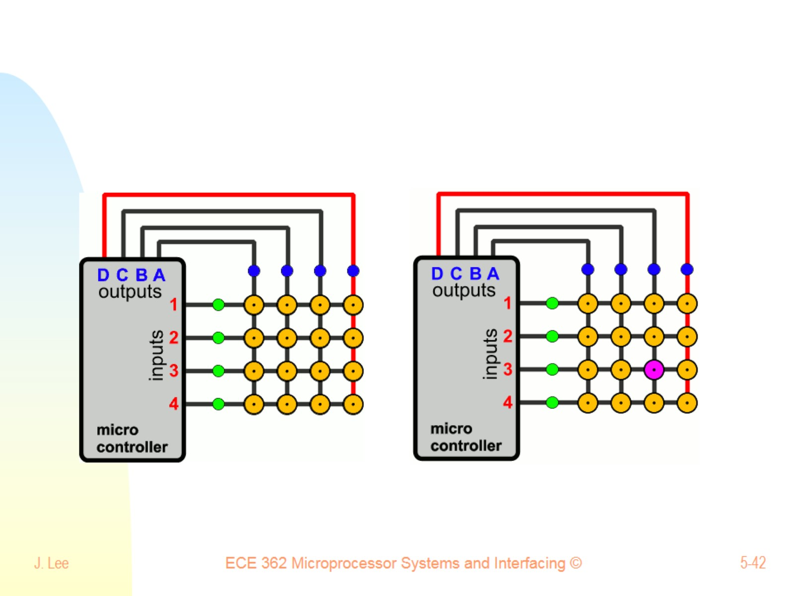

Slide 43
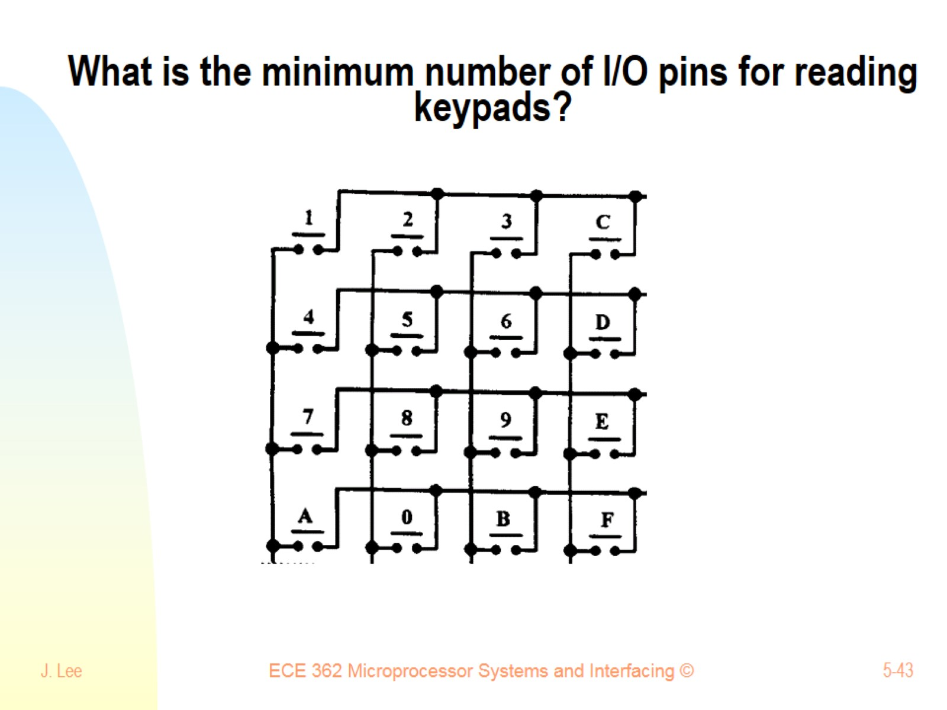
What is the minimum number of I/O pins for reading keypads?

Slide 44
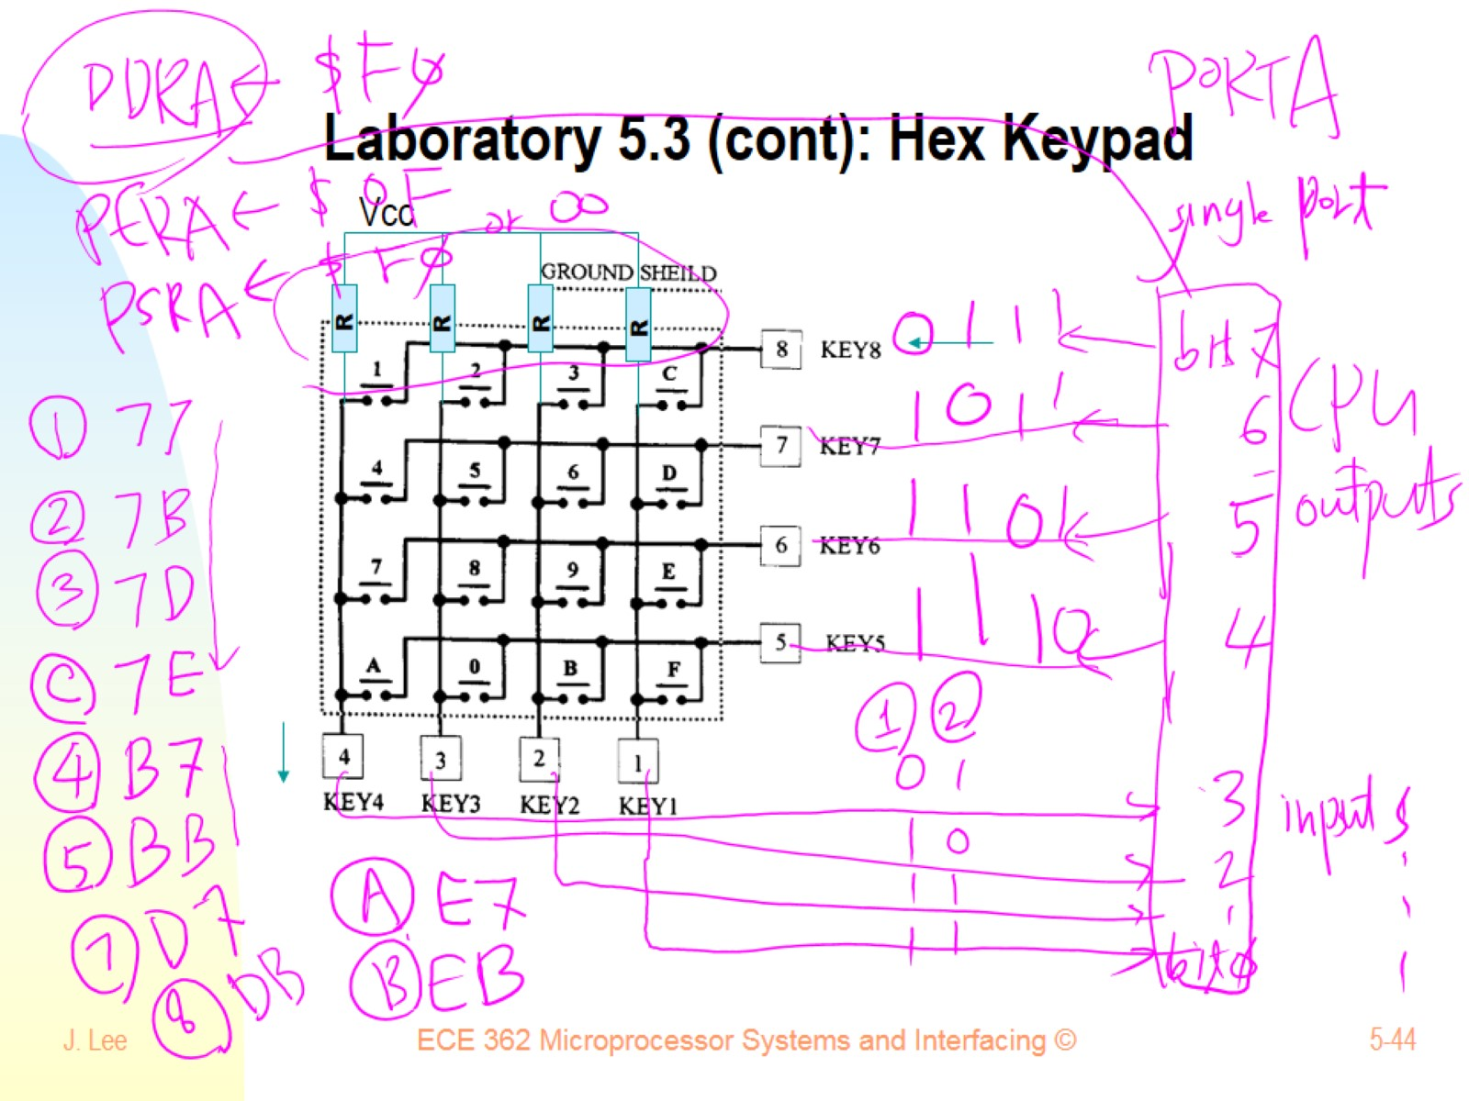
Laboratory 5.3 (cont): Hex Keypad

Slide 45
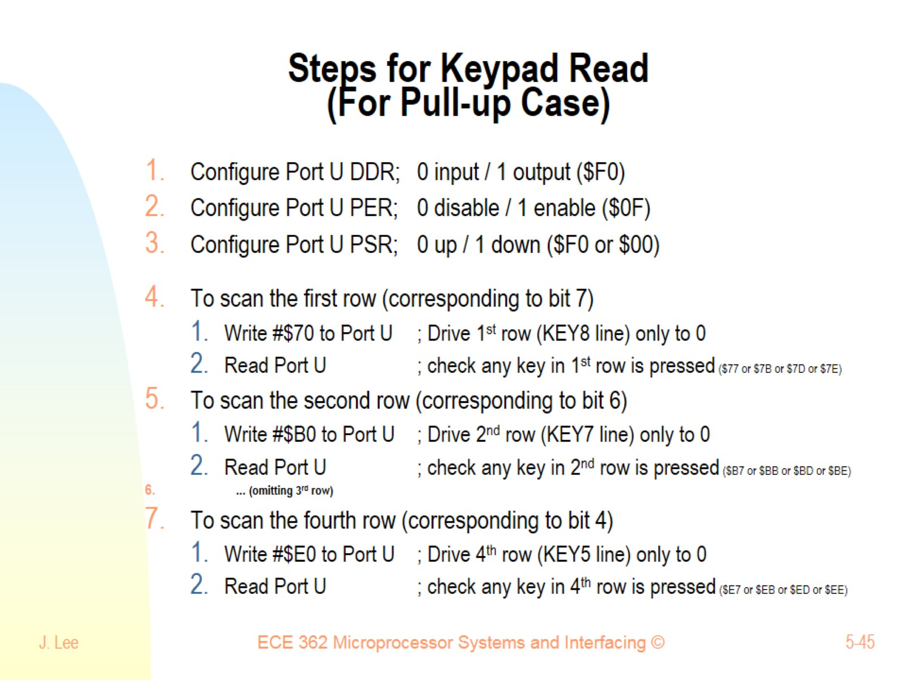
Steps for Keypad Read (For Pull-up Case)

Slide 46
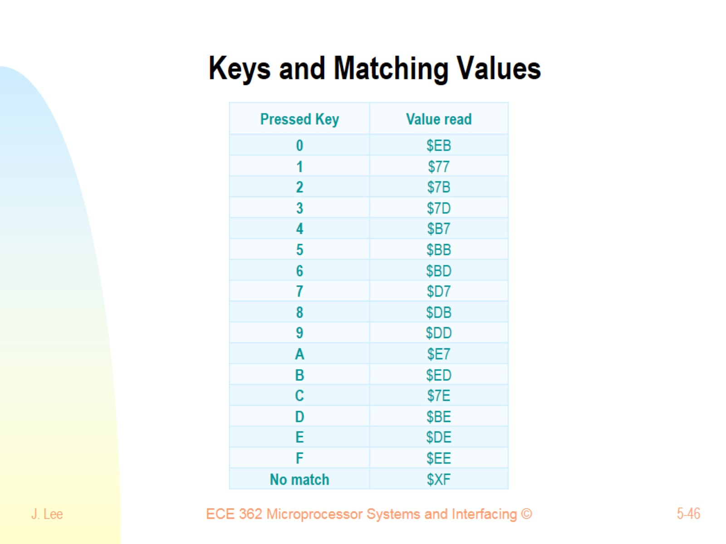
Keys and Matching Values

Slide 47
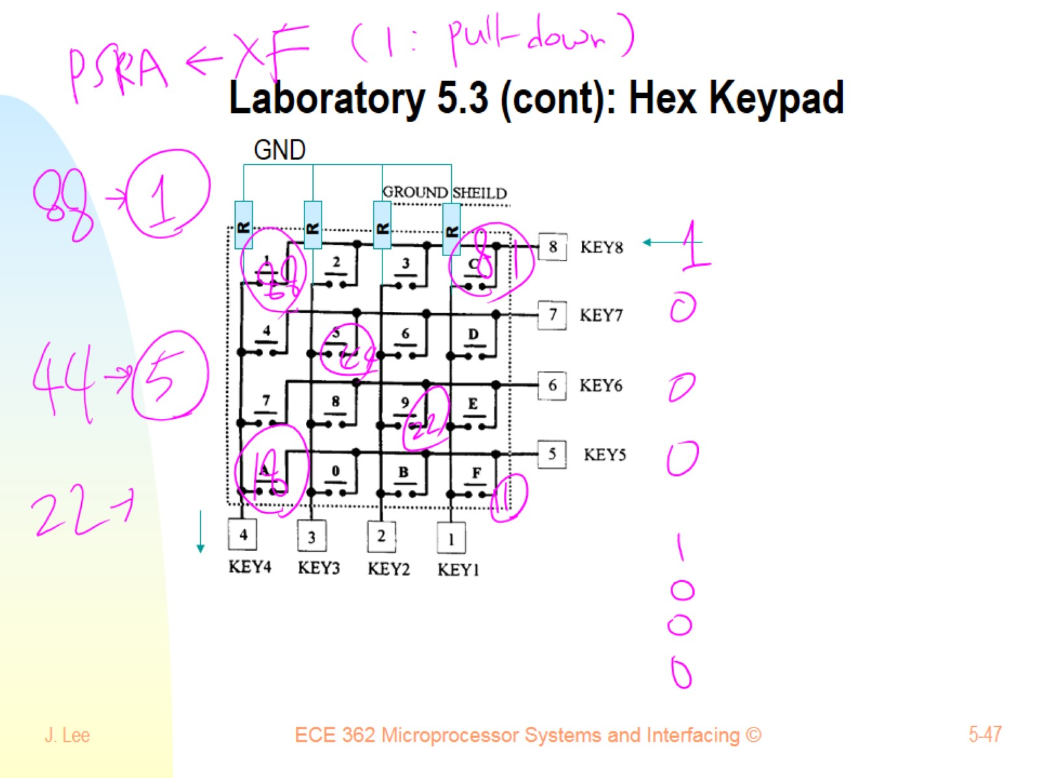
Laboratory 5.3 (cont): Hex Keypad

Slide 48
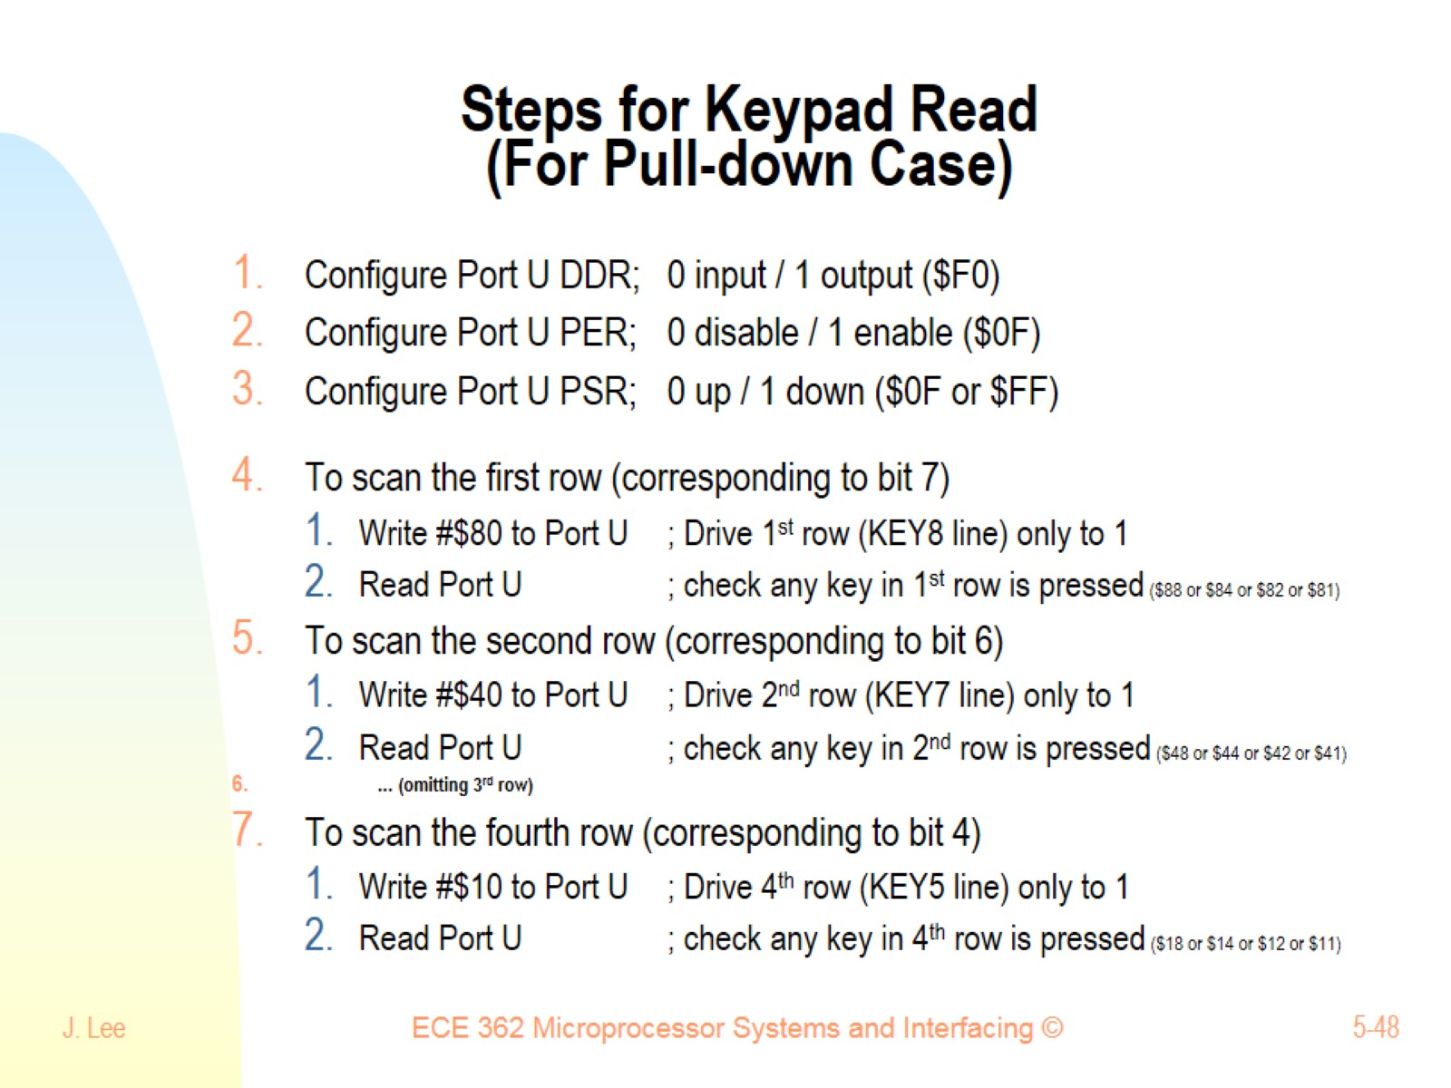
Steps for Keypad Read (For Pull-down Case)

Slide 49
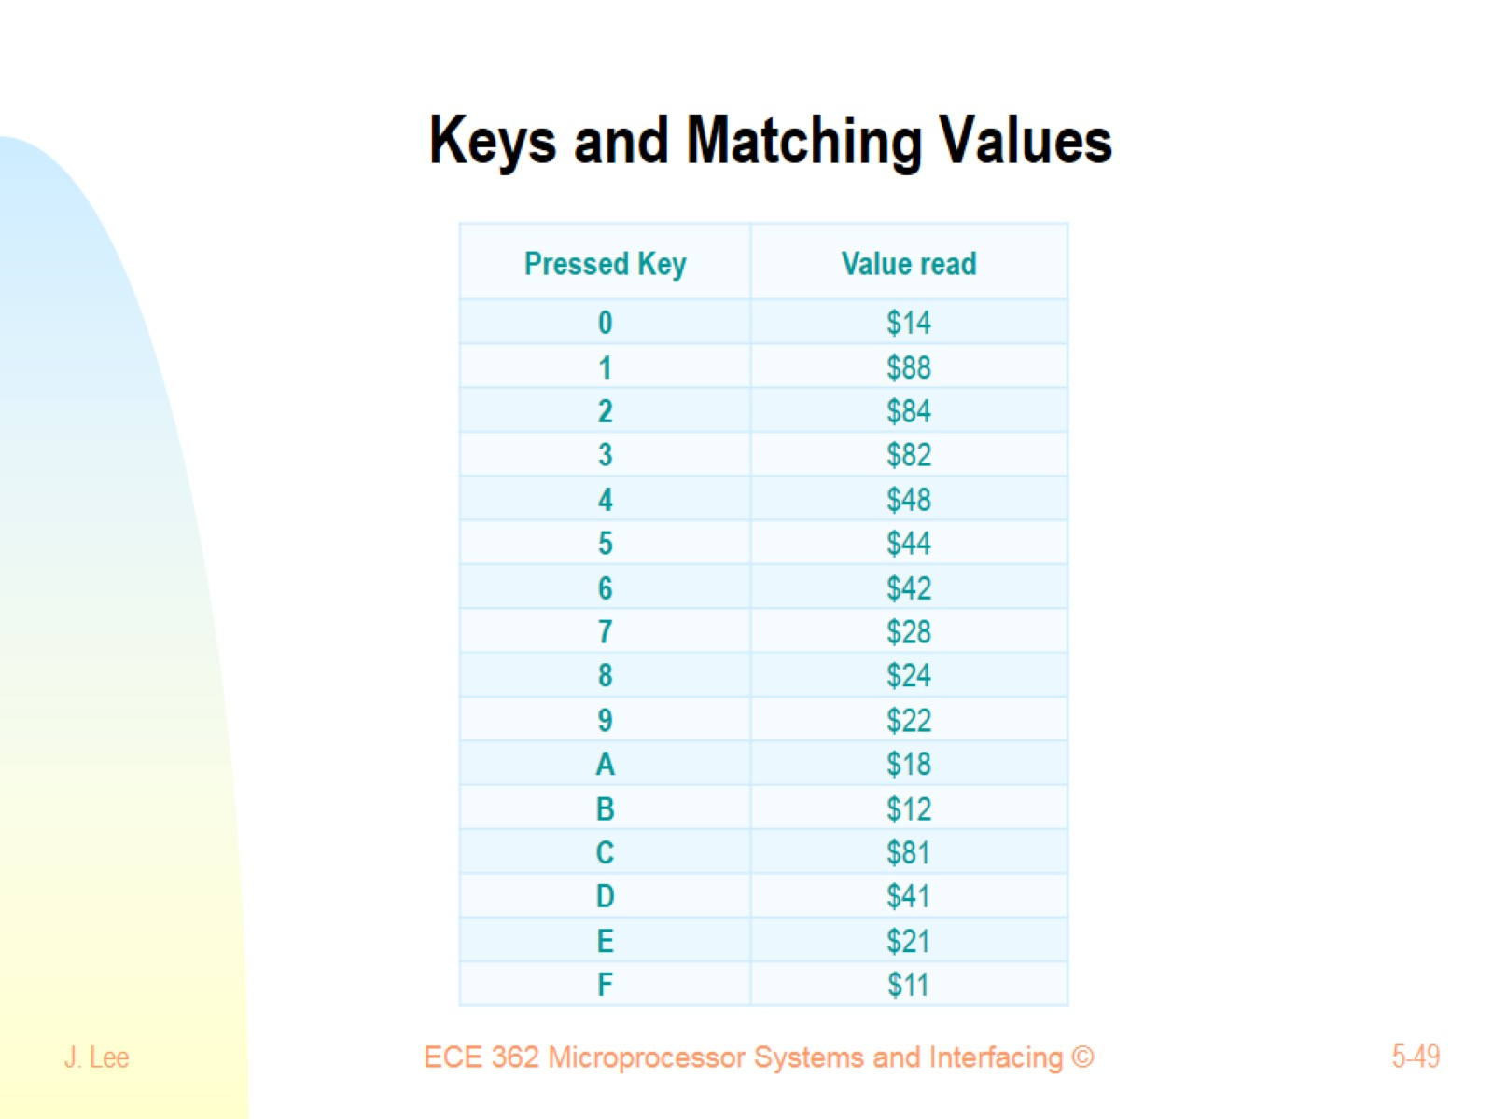
Keys and Matching Values

Slide 50
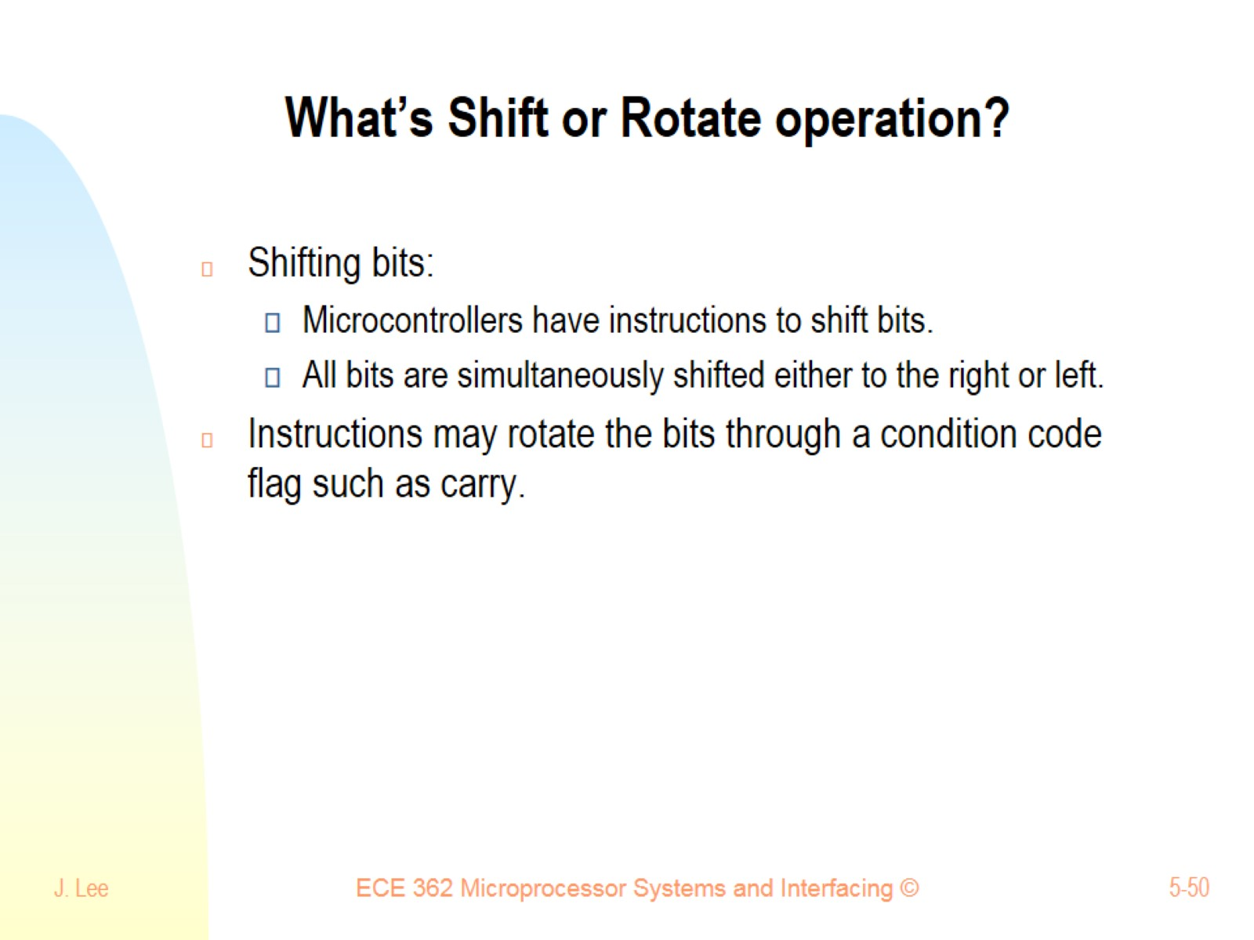
What’s Shift or Rotate operation?

Slide 51

Shift Right

Slide 52

Shifts Left or Right

Slide 53

Shifts Left or Right

Slide 54

Rotate Left

Slide 55

What kinds of Shift instructions?

Slide 56

Shift Instructions – LSL (and ASL)

Slide 57

Logical/Arithmetic Shift Left LSL and ASL

Slide 58

Shift Instruction - LSR

Slide 59

Shift Instruction - ASR

Slide 60

Shift Instruction - ASR

Slide 61

Shift Instruction - ASR

Slide 62

What kinds of Rotate instructions?

Slide 63

Rotate Instruction - ROL

Slide 64

Rotate Instruction - ROR

Slide 65

Shift instructions can be used to multiply or divide by power of two

Slide 66

Values after shift operation

Slide 67

Why to use Rotate instructions?

Slide 68

Mechanical Switches

Slide 69

Bouncing and How to deal with?

Slide 70

What’s Switch Debouncing?

